Slide 1



Synopsys Corporate Blog
Advances Thought Leadership
SEO and Audience-centric Content Extend Reach

Slide 2
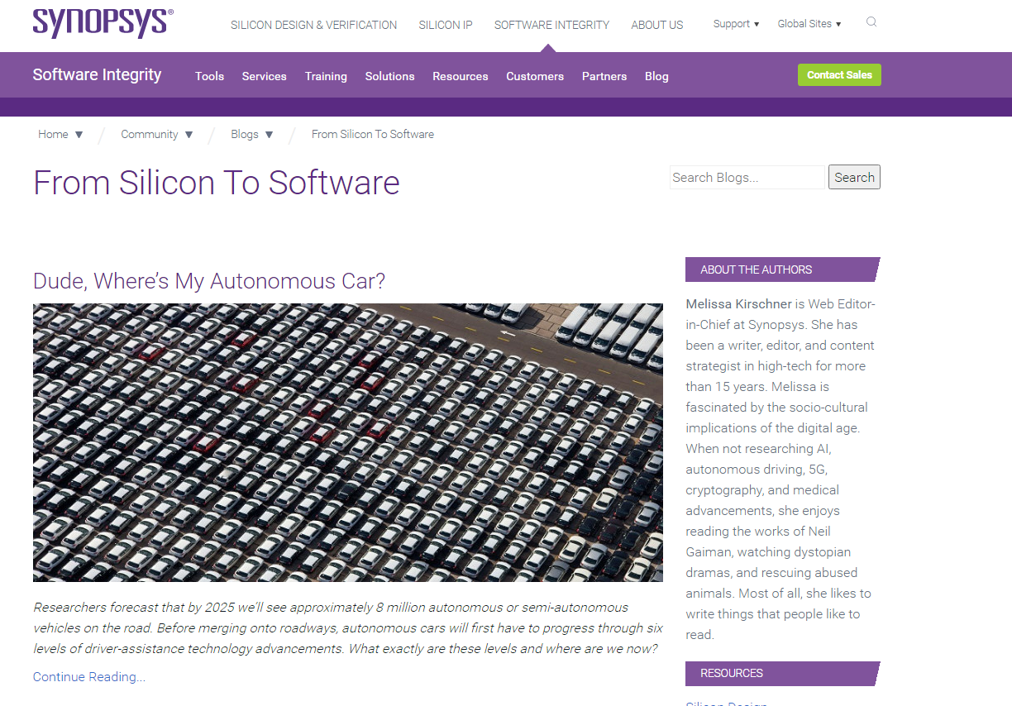
The Assignment
Synopsys wanted to extend the reach of the blog, appealing to a wider audience. More than produce fresh content, this meant optimizing the blog for organic search.
  We supported the in-house team in tapping multiple subject matter experts
  and amplifying thought leadership content.

Slide 3

SEO + Compelling Content:
The One-Two Combo
to Make the Magic Happen

Slide 4
Let’s Talk Content
Everyone has heard the mantra, “Content is king.”
  This is a lie; content is not king.
Compelling content is king. In this case, we defined compelling content as helping
readers do their jobs better.
We conducted sourcing sessions with subject matter experts to cull out story-driven
content and built out an editorial calendar focused on timely topics with product tie-ins
and company news.
Drilling down another level, posts strived for:
  Insights
  Education
  Triggers for fresh thinking
  Inspiration/motivation
  “Entertainment”
  Or a combination of the above

Slide 5
Let’s Talk Content
Applying a Publisher’s Mentality
(sampling of different types of posts WE CREATED)
POV on the industry
Research
POV on a news article (or issue in the media)
Listicles
Q&A
Education
Curated content
Synopsys-centric content
Synopsys executive perspective

Slide 6
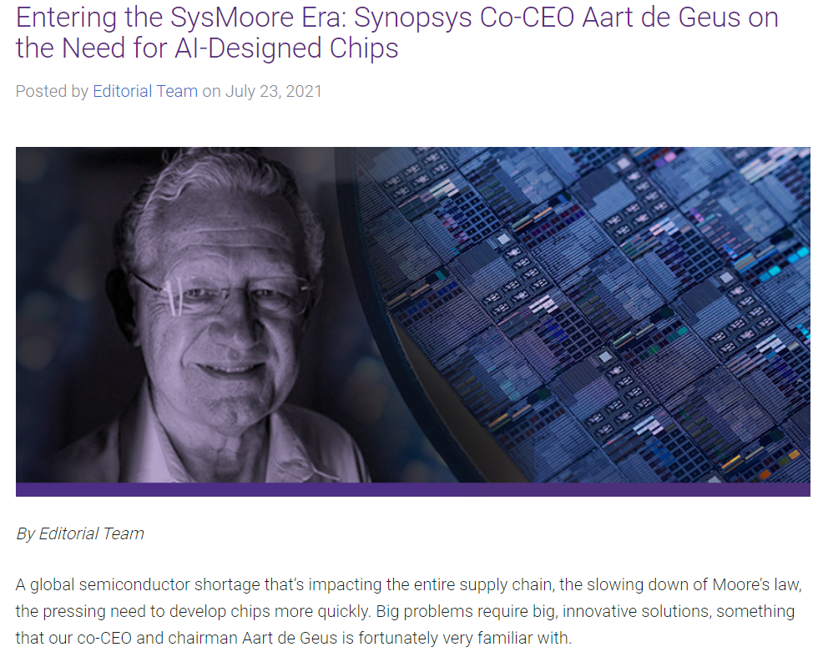
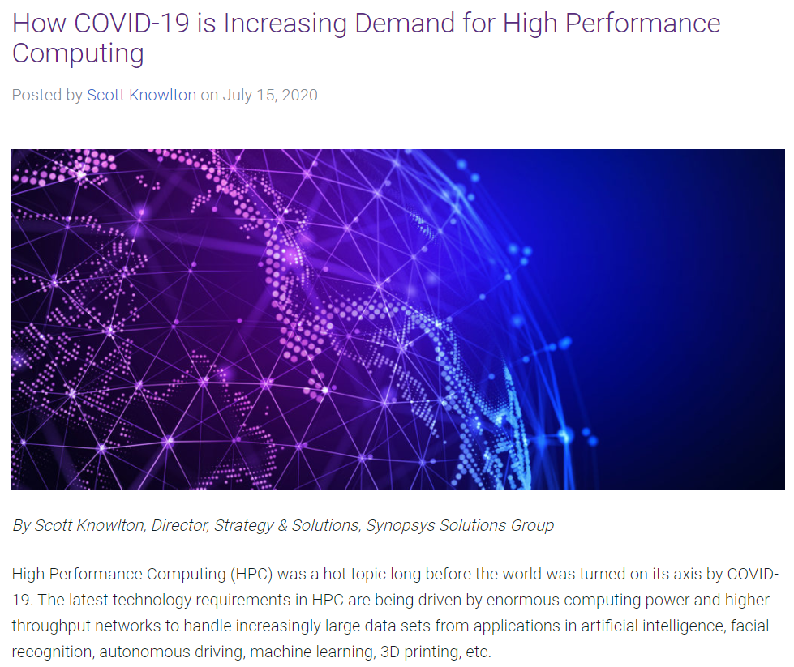

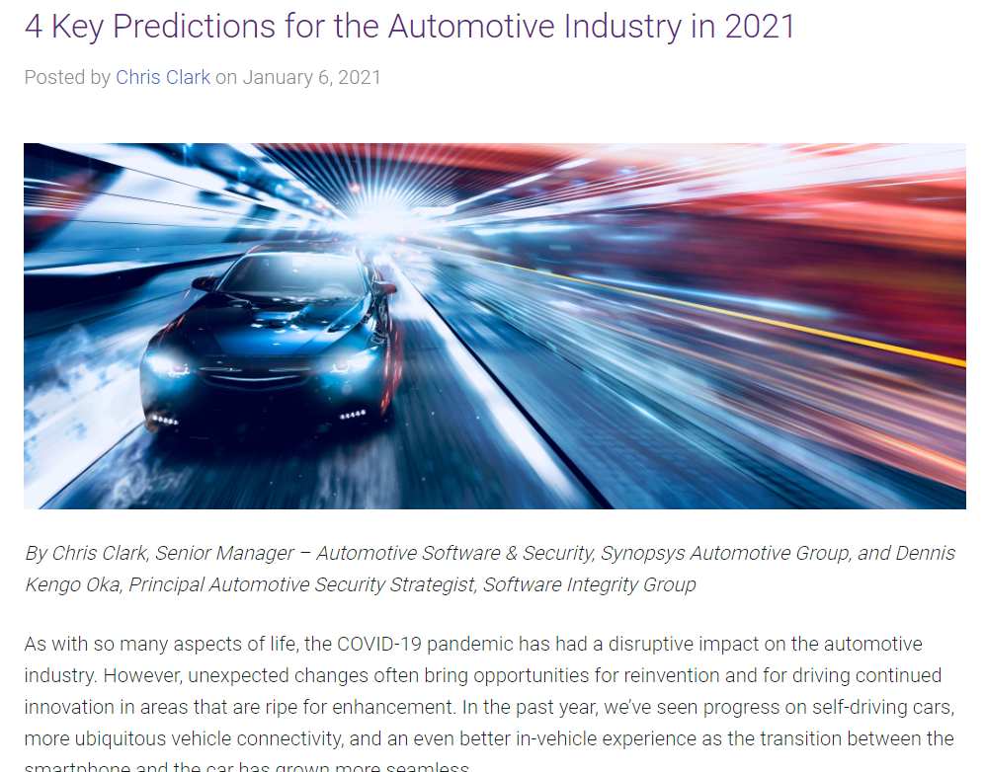
Elevating Synopsys’ Thought Leadership

Slide 7
Optimizing the Corporate Blog for Organic Search
We implemented On-page SEO Fundamentals
Researching and identifying keywords
Feathering keywords into copy
Constructing URLs with keywords
Developing the following meta data based on keyword research:
  Page title tags
  Page description tags
  Header tags (H1, H2, H3)
  Image file names and descriptions (image ALT tags)
Applying Schema.org markup
Shaping content to rank as Rich Snippets: Content to be perceived
by Google as providing an answer to a question

Slide 8

Thought Leadership Done Right
(SEO + Compelling Content) on a Blog Can Rank Above
Stories from Third-party Publications

Slide 9
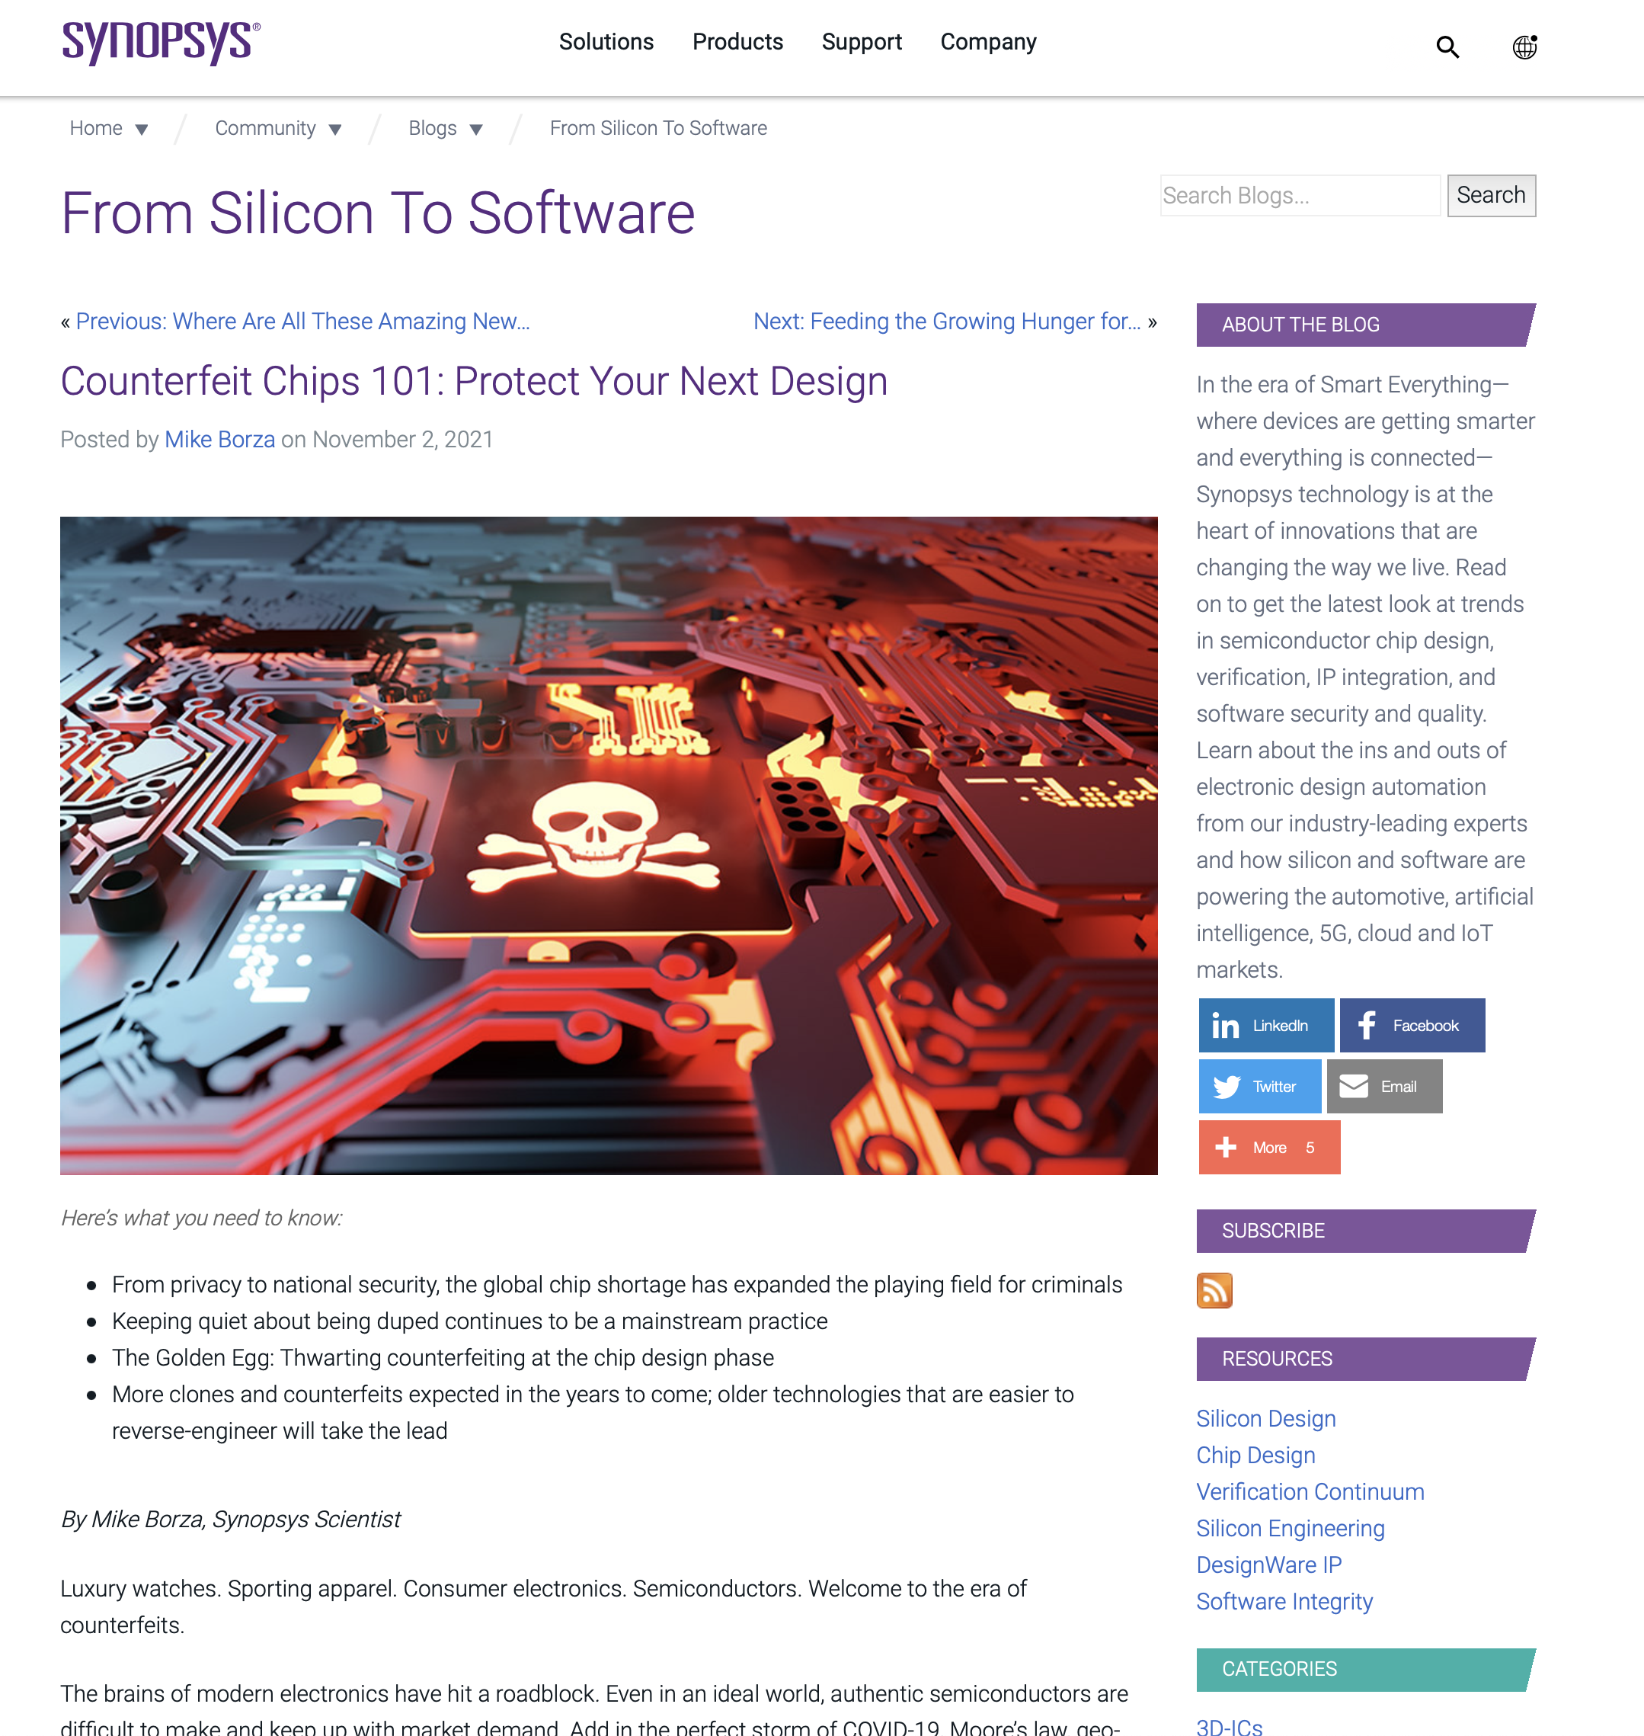
Mapping Content to Issues That Journalists Cover
For example, we created content around
the issue of counterfeit chips.
We took a journalistic-like approach with the overarching objective of educating the reader.
  Not “selling” Synopsys
The Google algorithm favors long-form content. Our story tips 1,300 words with links to other relevant media articles (just like journalism).

Slide 10
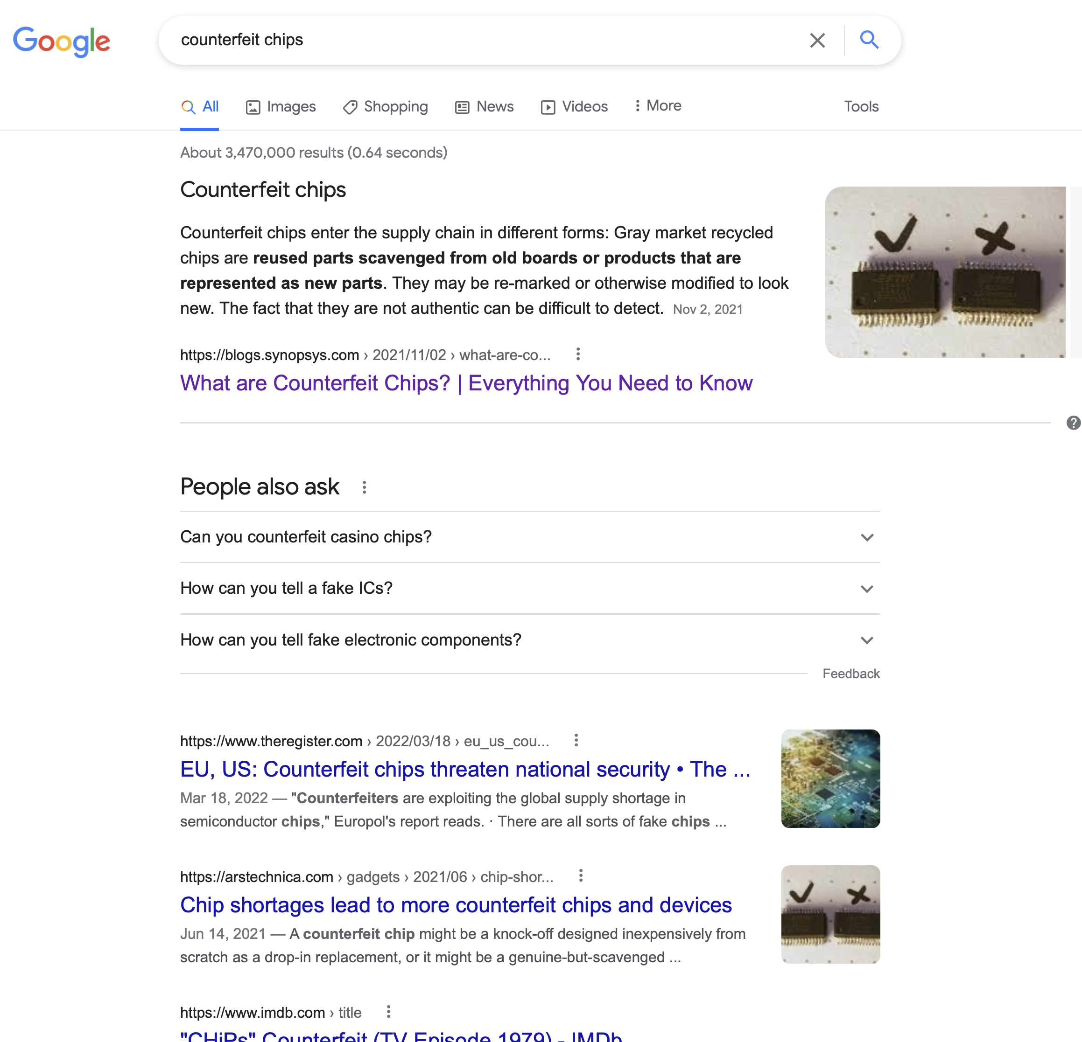
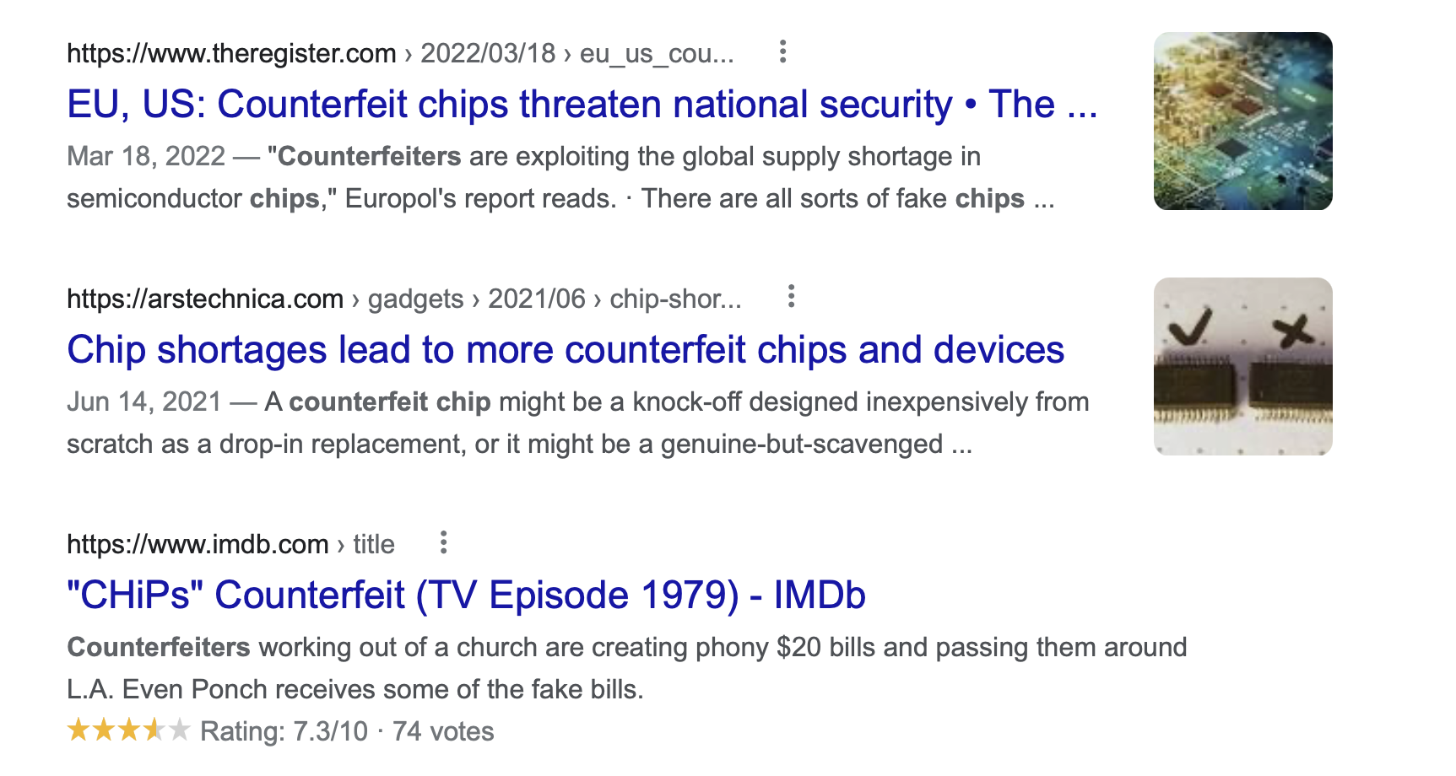
Mapping Content to Issues That Journalists Cover
Plug [counterfeit chips] into Google and you can see the Synopsys post often appears in the No. 1 position, outranking similar articles from Ars Technica, The Register and Tom’s Hardware, among others.

Slide 11
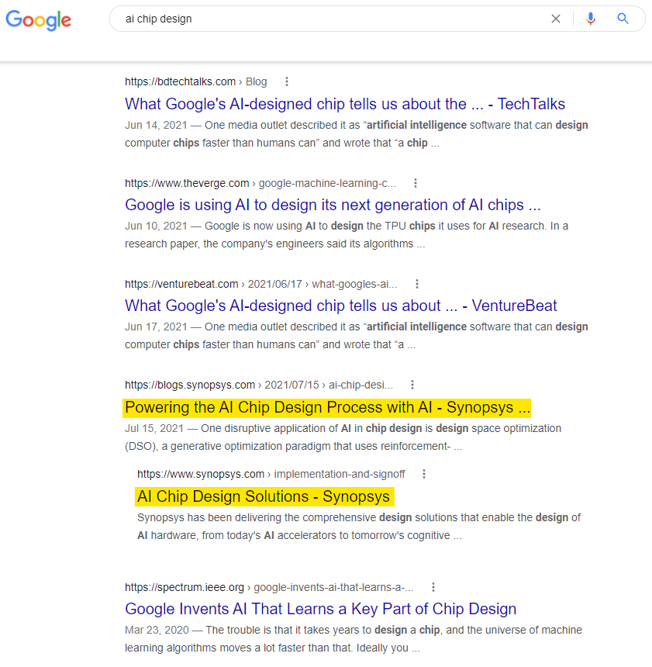
Overall Blog Results
“From Silicon to Software” now ranks in
the SERP (search engine results page) for
over 500 additional organic search terms, including valuable unbranded terms.
Organic search traffic has the highest engagement of any traffic source to
the blog.
The blog has gained over 700 new backlinks from different referring domains, including industry publications.
  A “vote” for the quality of the content.
Finally, average time spent on-site is extremely high, again reflecting quality content that people actual read.

Slide 12
Let’s connect
The Hoffman Agency
Worldwide HQ
325 South 1st Street, 3rd Floor
San Jose, CA 95113
+1 (408) 286 2611
Let’s connect
©2022 The Hoffman Agency

