Slide 1
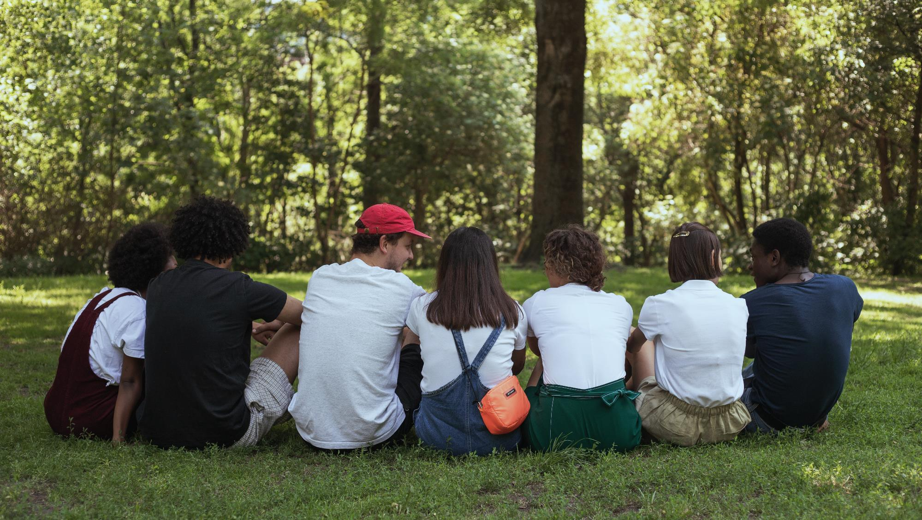

Making the Case for Snapchat as the Platform
for Real Friendships
SEO and Audience-centric Content Extend Reach

Slide 2
Challenge: Prove that Snapchat Values Real Friendships
When people “realize that competing with their friends for likes” is not great, they’ll turn to Snapchat, which focuses on building connections with fewer people but actual friends.
– Evan Spiegel speaking to CNBC

Slide 3


Opportunity
It’s one thing to say Snapchat values friendships; we needed the data to back it up.
While plenty of research had been done on romantic and familial relationships, a void existed when it came to friendship studies.
We proposed a global friendship study
to establish Snapchat as an authority
on friendship.

Slide 4
Framing the Research
We partnered with Snapchat to launch a global survey in nine markets
around the world to better understand how culture, age and technology
impact friendships.
The research and findings served as a basis for Snapchat to show it as the platform that cares most about facilitating close relationships.
The Hoffman Agency led the U.S. PR efforts and helped shape the research questions and approach to drive compelling stories.

Slide 5
Framing the Research
Turns out there are several definitions of friendship; we homed in
on “best friends” to shape our story.
Best Friend: someone you share everything with.
Good Friend: someone you rely on and can trust.
Acquaintance: someone you are friendly with, but your relationship
is not as deep or vulnerable.

Slide 6

Finding a Credible Expert
To lend credibility to the study, we needed to find
the “right” third-party influencer to help us tell the story:
  No affiliation with another social networking company
  (we had to disqualify our first pick for this very reason)
  Credentialed (a recognized friendship researcher;
  a Ph.D. was ideal)
  Comfortable on camera (NBC’s “Today Show” was in our sights)
  Writing chops (delivering a byline was a prerequisite)

Slide 7
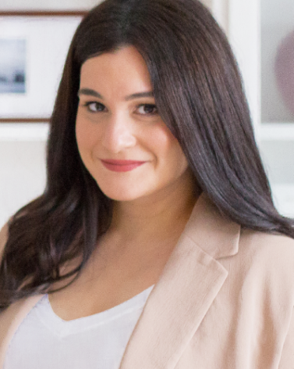
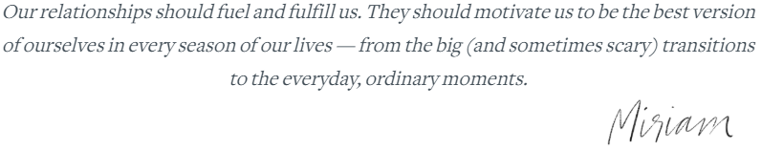
Finding a Credible Storyteller
Miriam Kirmayer, Ph.D., fit the bill:
  A recognized authority on friendship who brought
  the added credibility as a clinical psychologist
  Expert resource regularly quoted in top media, such as
  The New York Times, TIME and CNN

Slide 8
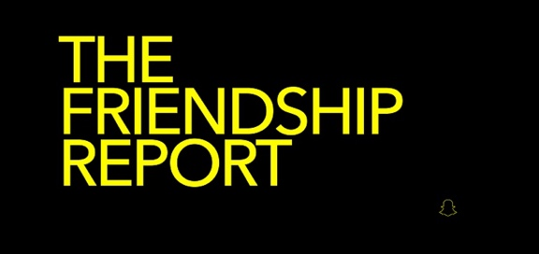
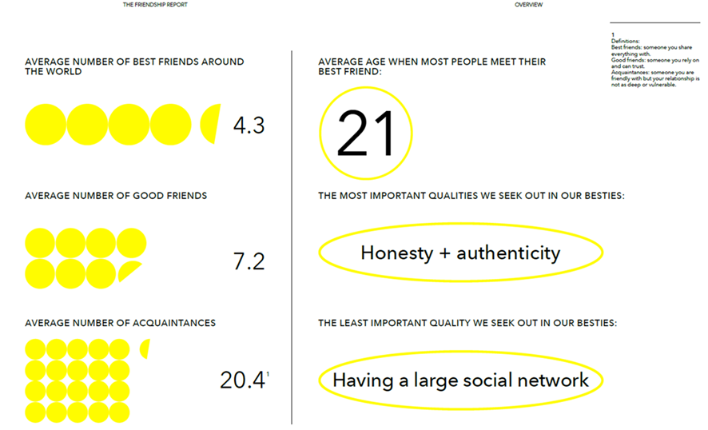
Bringing the Story to Life
After sifting through the
48-page Friendship Report,
we teased out the newsworthy data points.

Slide 9
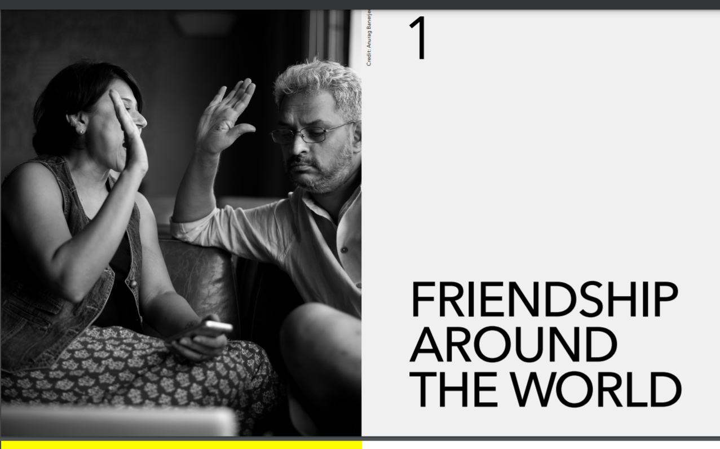
Bringing the Story to Life
You can access the full
report at
https://forbusiness.
snapchat.com/blog/
the-friendship-report.

Slide 10
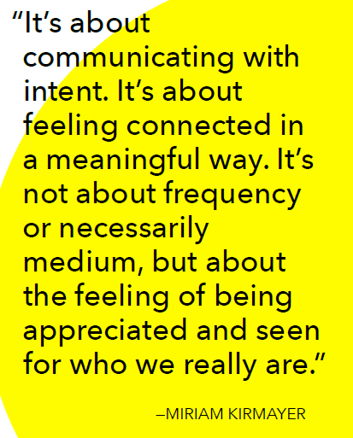
Bringing the Story to Life
We packaged up provocative storylines
and soundbites.
We served as a gut check on Snapchat’s presence in the research to ensure the content wasn’t overly promotional.

Slide 11

Media Strategy
Create buzz and drive media interest before the research is announced via embargo outreach.
Drive home insights that are contrarian/surprising for maximum impact.
Offer 1:1 interviews with Snapchat and third-party spokesperson
to bring the research and story to life.
Outreach to broad set of media, including consumer,
lifestyle, business, metro dailies in top markets.

Slide 12
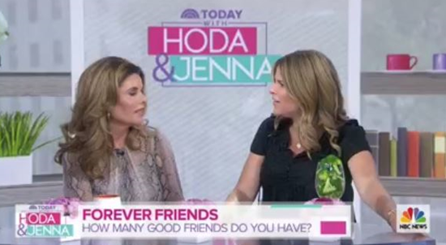
Making Headlines on the “Today Show”
We homed in on NBC’s “Today Show” as a target for the research results.
The Friendship study was featured on launch day on “Today with Hoda & Jenna” during the Forever Friends segment.
The hosts discussed the results
of the study and shared findings
around the average number
of best friends, good friends
and acquaintances people have
across the globe.

Slide 13

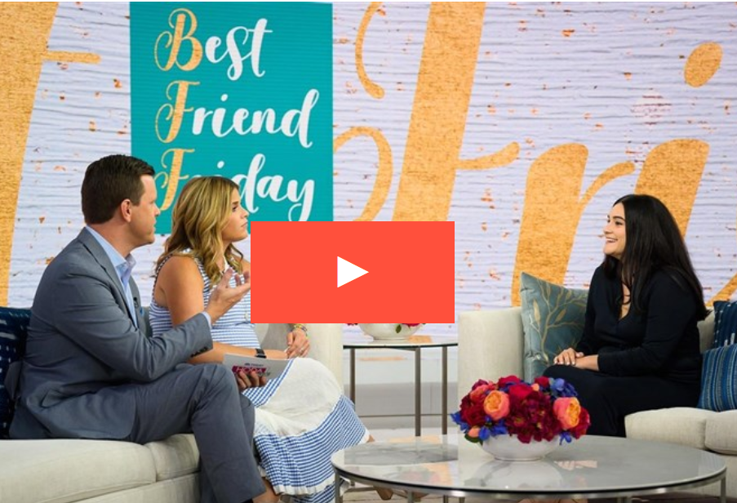
Not One, but TWO Segments on the “Today Show”
We also pitched “Today with Hoda & Jenna”
to feature the research as part of their
Best Friend Friday series.
We positioned therapist and friendship researcher Miriam Kirmayer as an on-air guest — securing a full interview segment.
With Miriam’s interview locked in, Hoffman prepped her to highlight key findings and bring context to the research.

Slide 14
Placing a Signature Story with The Wall Street Journal
We targeted WSJ bureau chief Clare Ansberry knowing she regularly
covers relationships.
After biting on our embargo pitch, Ansberry requested an interview with
Miriam Kirmayer and Snap Inc. head of consumer insights Amy Moussavi.
Ansberry wanted to build the story around the stat she found of particular interest: globally — most people meet their life-long best friend at the average age of 21.
She gave us a 4-hour window to find a real-life example who was available
for a phone interview that weekend.
We sent out a mayday to our agency network and within 30 minutes struck gold
with a coworker whose cousin and her best friend had met in college — at age 21.

Slide 15

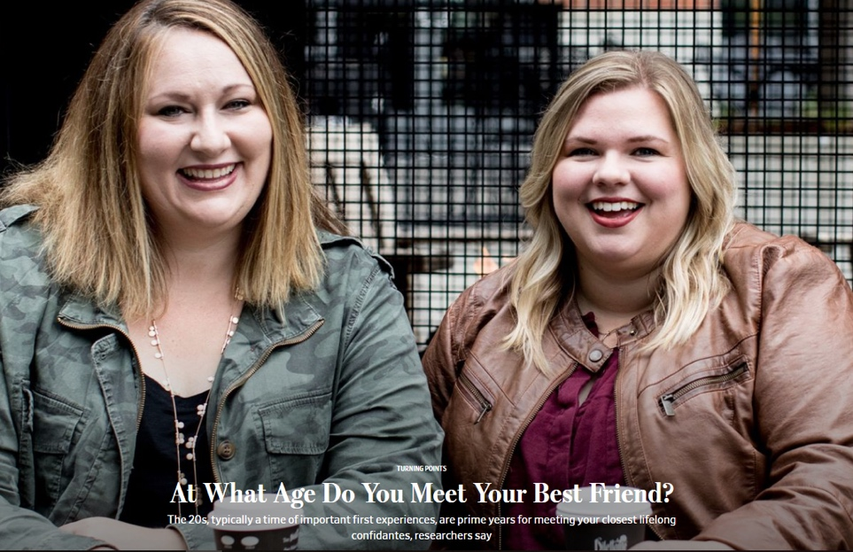
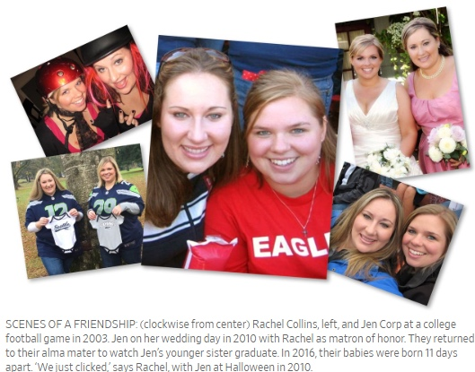
Placing a Signature Story with The Wall Street Journal
The result was an in-depth article that
ran online and in the most-read Sunday edition of the paper — above the fold
in the Life & Arts section.

Slide 16
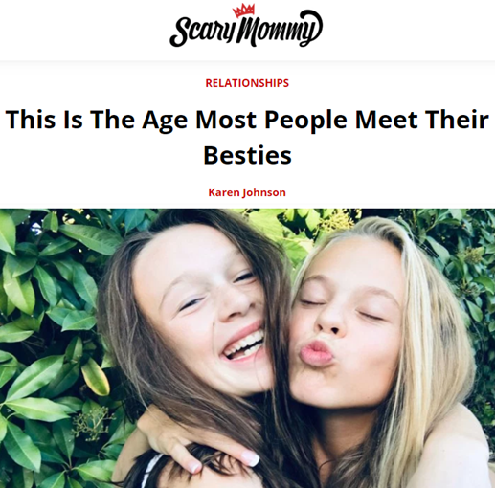
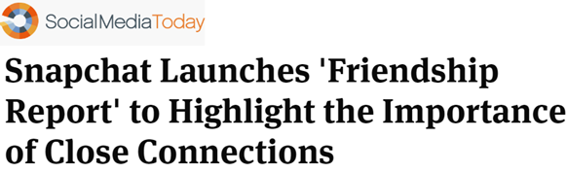
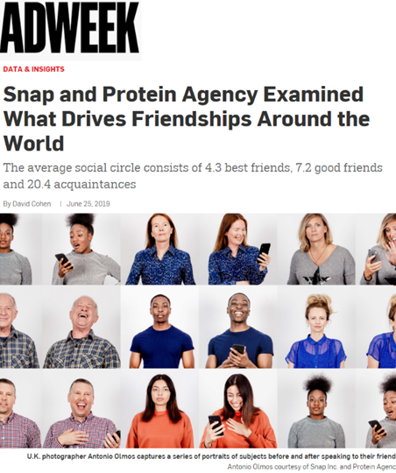
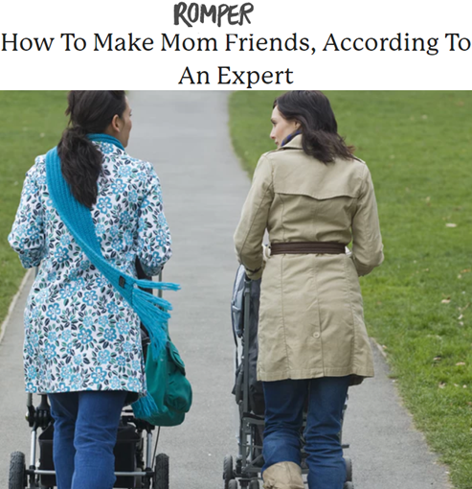
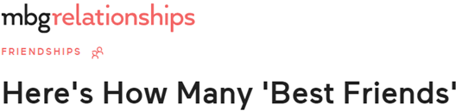


The Results Kept Coming

Slide 17
Let’s connect
The Hoffman Agency
Worldwide HQ
325 South 1st Street, 3rd Floor
San Jose, CA 95113
+1 (408) 286 2611
Let’s connect
©2022 The Hoffman Agency

