Slide 1

Elevating Nokia’s POV
on How the Pandemic Impacted the Internet
Leveraging a News Cycle for Thought Leadership

Slide 2

Setting the Stage
We support Nokia’s B2B software business, which includes a security and intelligence platform called Deepfield.
When the Covid-19 lockdowns started to occur, we anticipated this would impact internet bandwidth.
Nokia deployed Deepfield to analyze
network performance (before lockdown/
after lockdown).

Slide 3
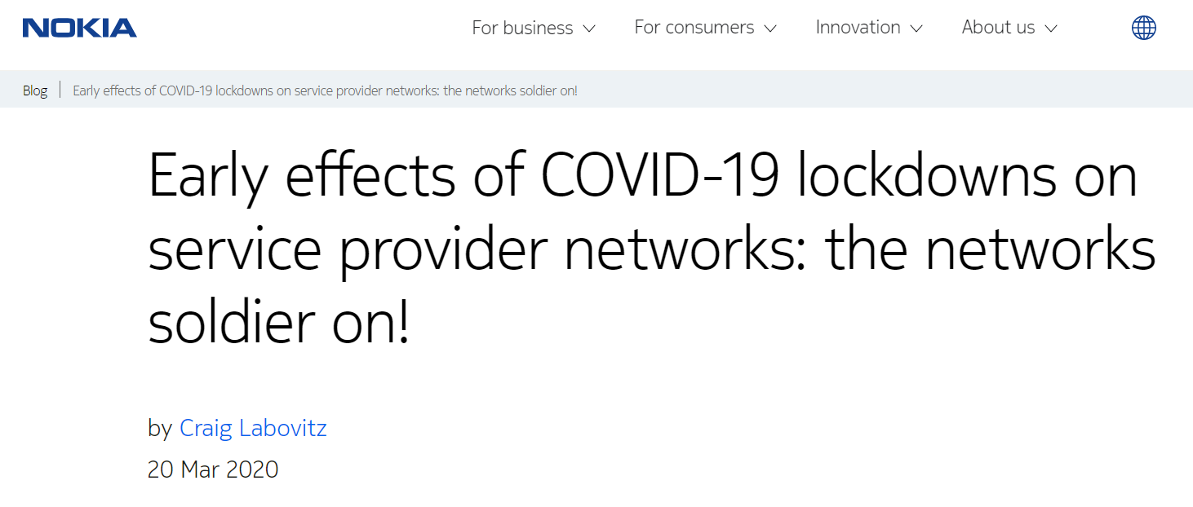

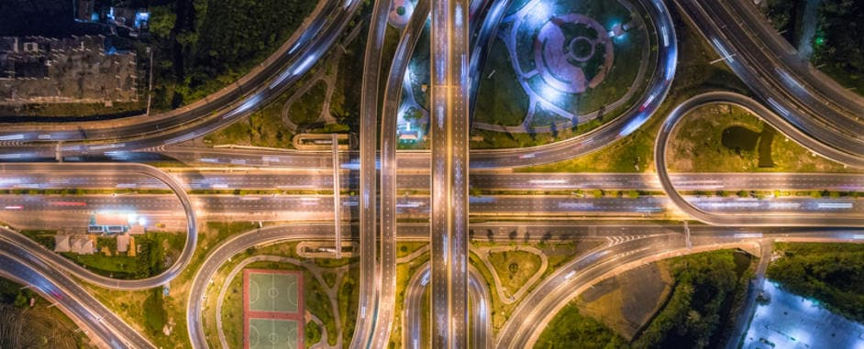
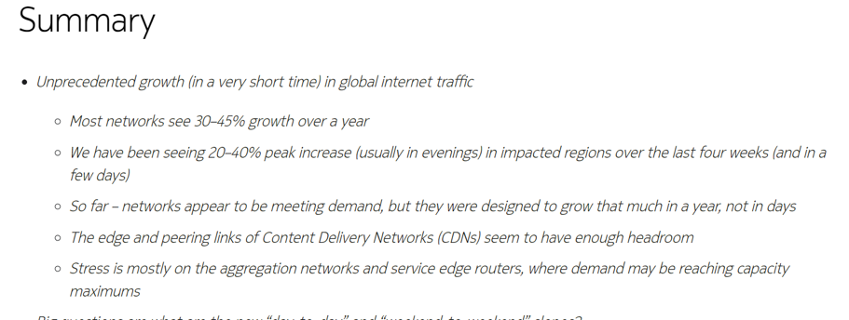
Nokia Deepfield Campaign Capitalizes on News Cycle
Establishing a Campaign “Anchor”
We leveraged owned media, Nokia’s blog,
to initially establish the company’s POV on the pandemic’s impact on the internet.
  This way, journalists could see — sometimes
  with our helpful pointers — that Nokia was
  an early voice on the issue.
We worked with the Deepfield CTO to mine
what we thought would provide “hooks”
for journalists.
  Pulling data specific to Netflix and WhatsApp

Slide 4
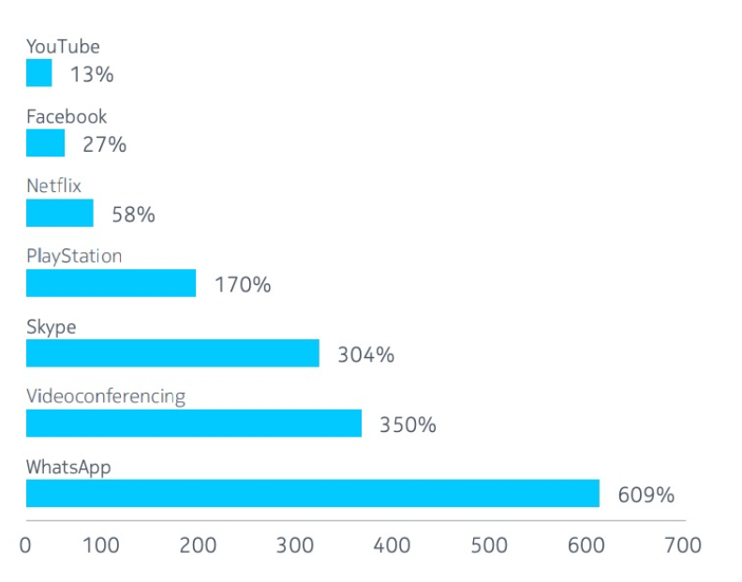
Humanizing the Nokia Story Extended Media Reach
DRILL DOWN INTO THE NOKIA DATA
No surprise, the pandemic caused an increase in applications, which in turn impacted internet performance.
Taking this a step further so the average person would understand, we worked with Nokia to isolate individual applications and their impact on the internet.
By humanizing the story, we believed this would land with journalists.
  It did.

Slide 5

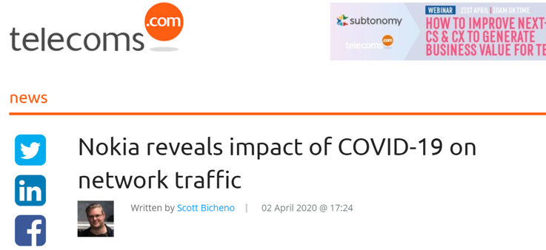
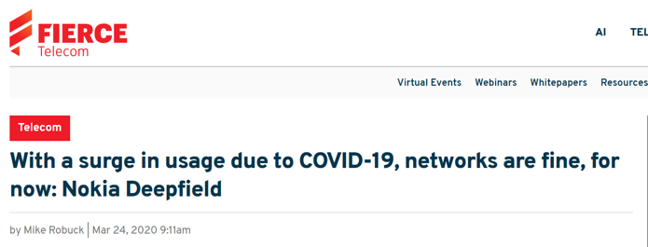
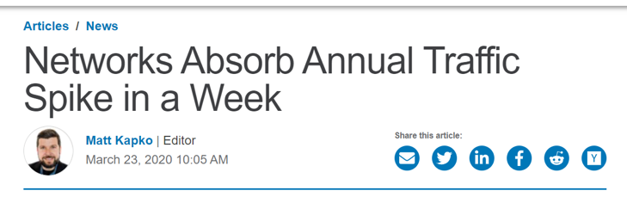
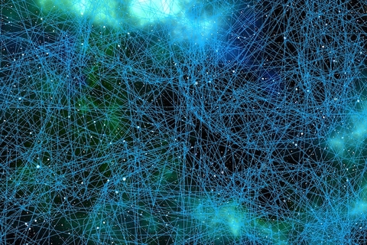
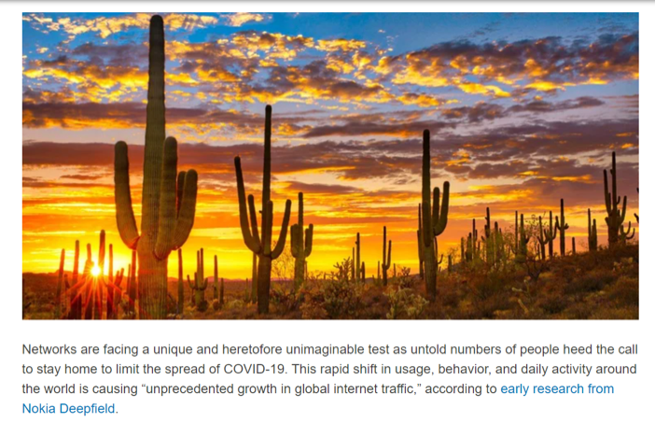

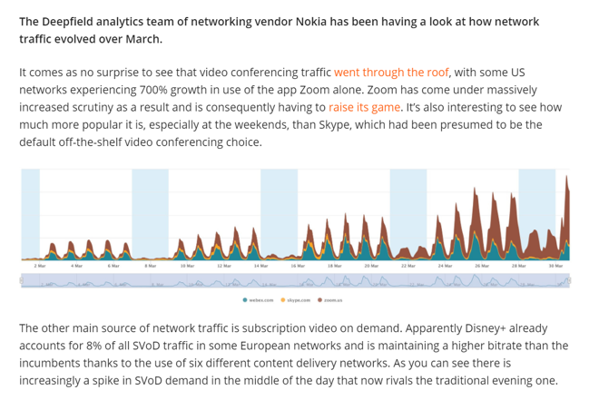
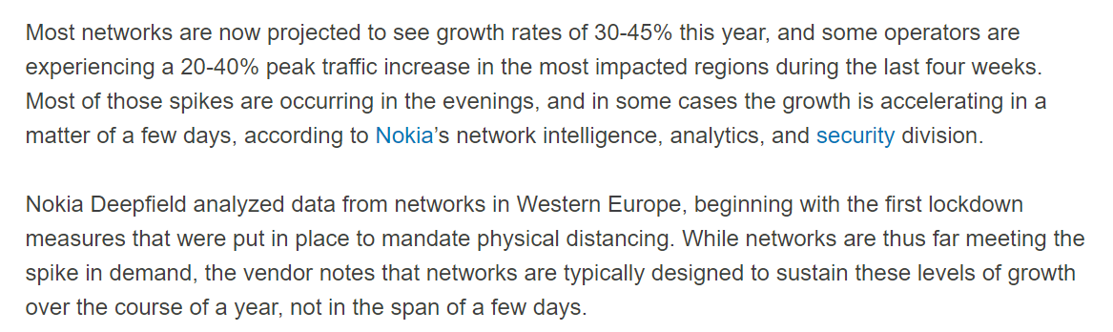
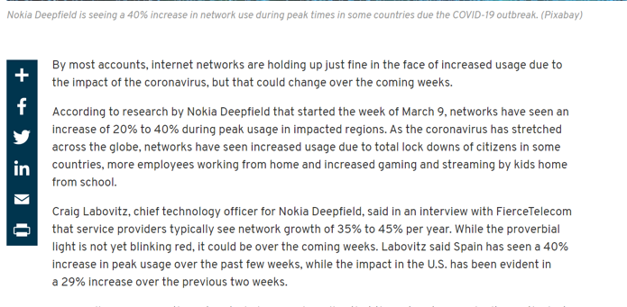
Shaping Pitches That Land with Journalists
The Trade Books Responded to Our First Wave of Pitches

Slide 6

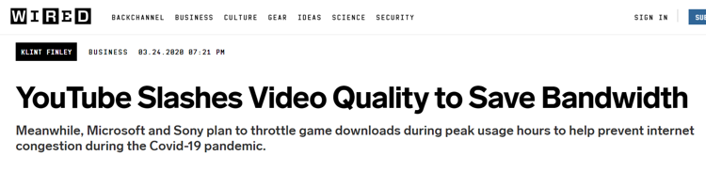
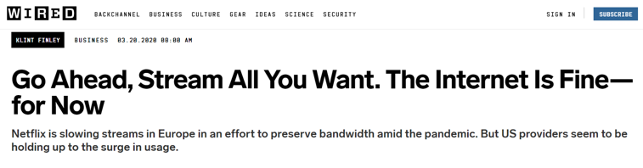
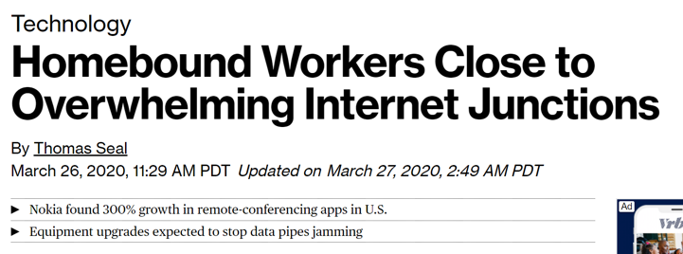

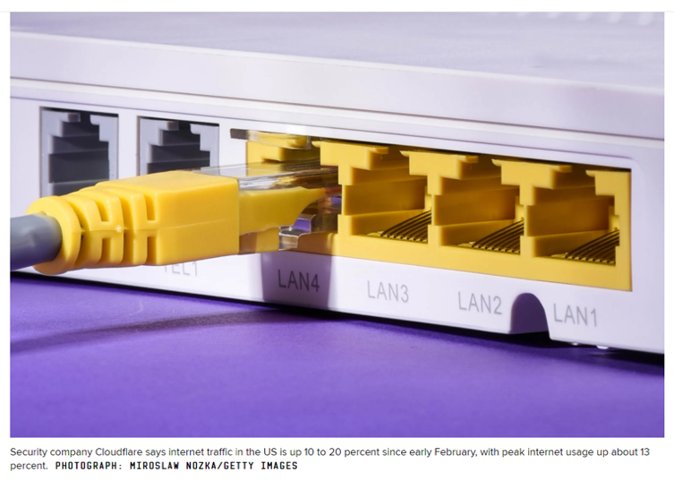
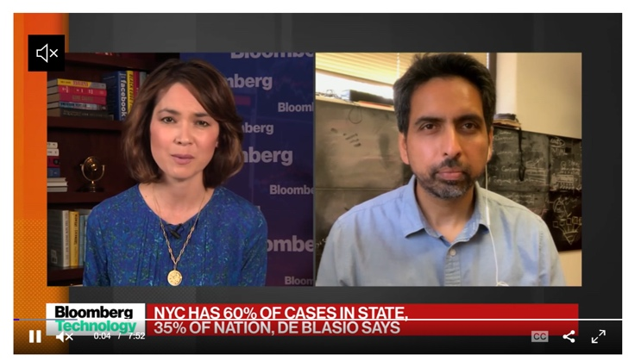
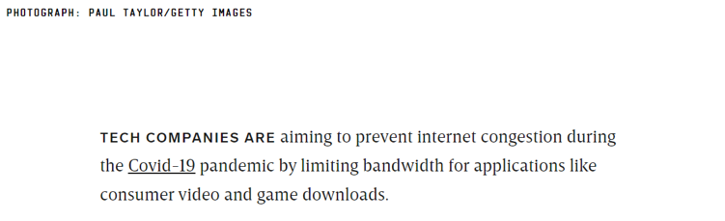
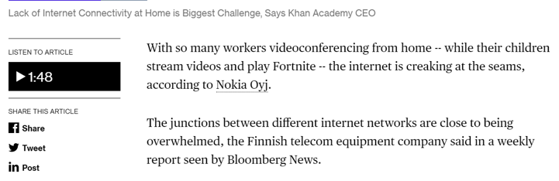
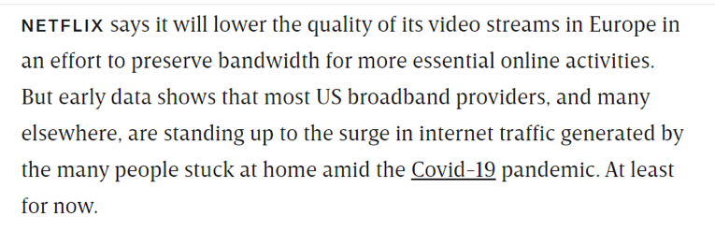
Shaping Pitches That Land with Journalists
As Did Business and Mainstream Media Including Bloomberg and Wired (twice)

Slide 7

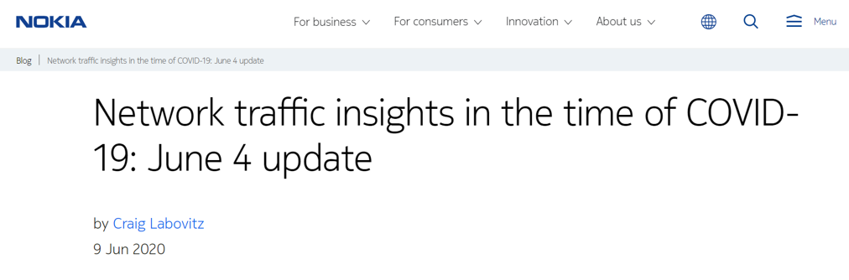
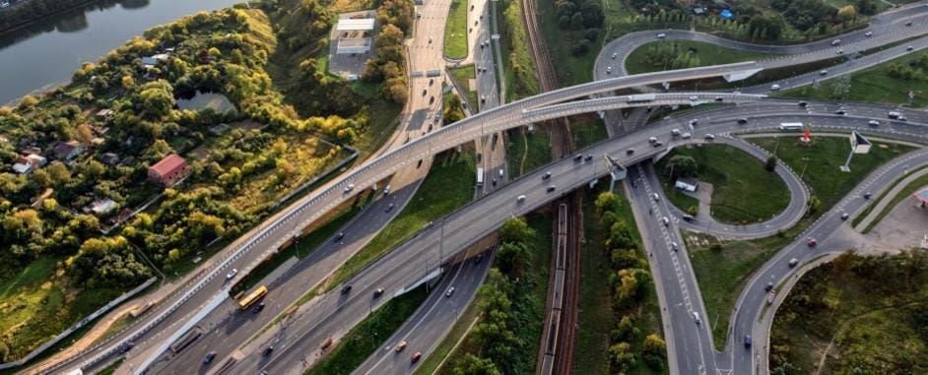
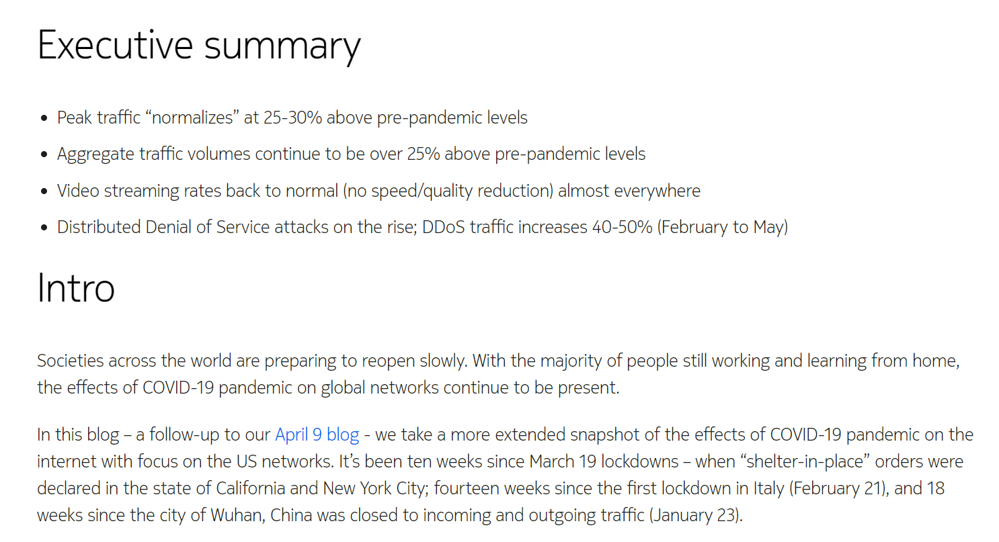
Sustaining the Nokia Deepfield Campaign
Looking Beyond Initial Push
We teamed with Nokia to continually replenish the narrative with fresh content.
  Included publishing more blog posts.
And continued pitching both trade and business journalists.

Slide 8
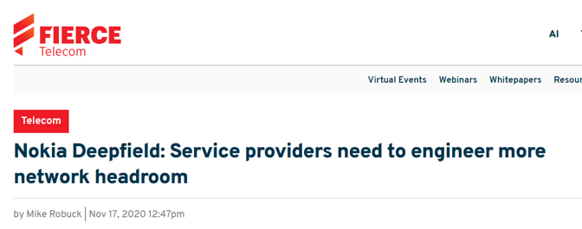
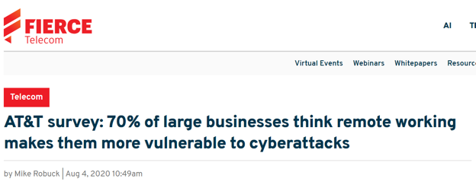



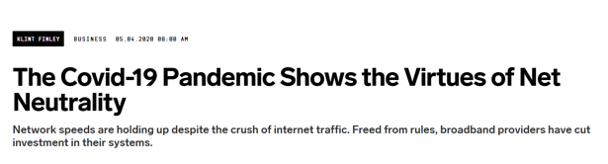
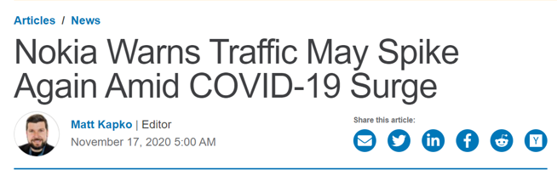
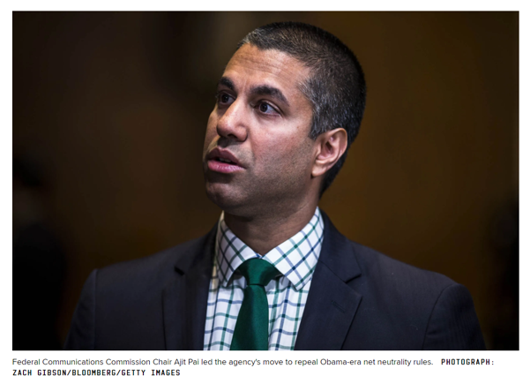
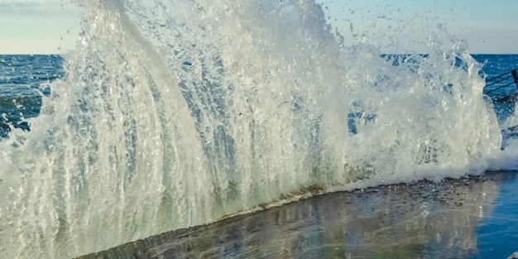
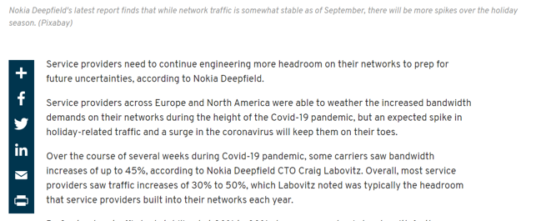
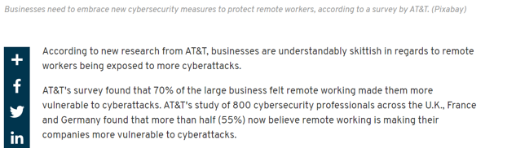
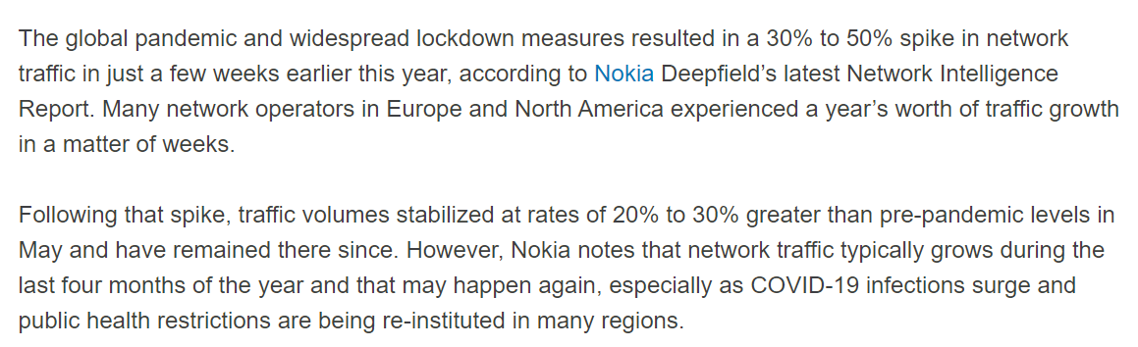
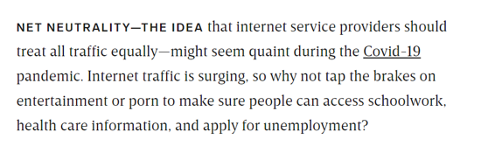
Sustaining the Nokia Deepfield Campaign
Sample Coverage FROM CONTINUED MEDIA PUSH

Slide 9

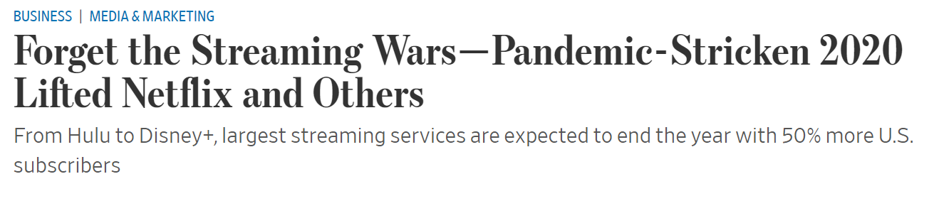
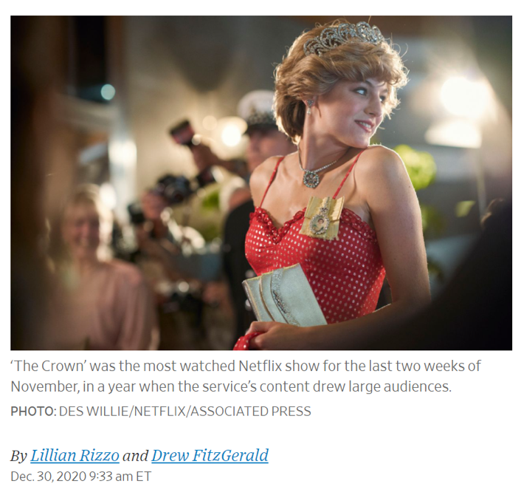
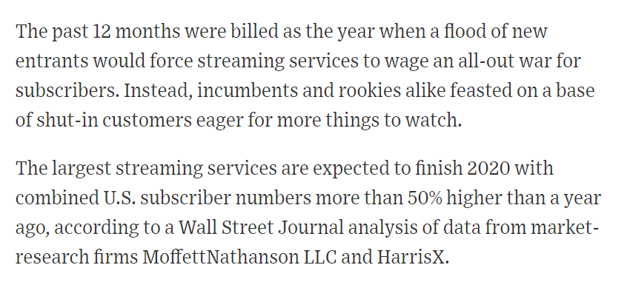
Sustaining the Nokia Deepfield Campaign
By Establishing a Beachhead
at the Start of the News Cycle, Journalists called us.
The best example of this is the Journal
reaching out to us for Nokia Deepfield
data and input.
The gap between Netflix usage on weekends and weekdays also shrank as homebound customers had more opportunities to consume programming on weekdays, said Craig Labovitz, chief technology officer of Nokia Deepfield, the telecom-equipment maker’s network analysis unit.

Slide 10
Let’s connect
The Hoffman Agency
Worldwide HQ
325 South 1st Street, 3rd Floor
San Jose, CA 95113
+1 (408) 286 2611
Let’s connect
©2022 The Hoffman Agency

