Slide 1


How Clients Get
the Most Out of Us
The Client/Agency Relationship

Slide 2
The
The better we know you
our
work.

Slide 3
Product Management
R&D
Engineering
Senior Executives
Marketing
Sales
HR
With this in mind,
client provides
multiple touch points
(including sales)
to round out
our perspective

Slide 4
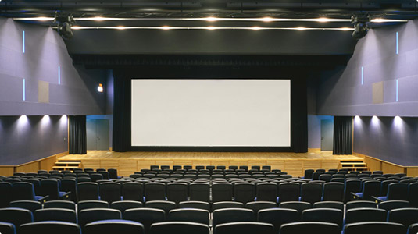
Which delivers the
BIG PICTURE

Slide 5

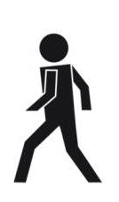
Client also believes different views and
even a periodic disagreement ultimately
strengthen the work.

Slide 6

  Give it to us straight.
  We can take it.
The Good,
The Bad &
The Unattractive

Slide 7

The job at hand aligns with the budget.

Slide 8
Defining the Relationship
Agency
treated as extension of the internal team

Slide 9
Defining the Relationship
Mutual respect
Open talk
Empowerment

Slide 10

Defining the Relationship
Defining the Relationship
Shared responsibility
for definition of PR success

Slide 11
We don’t mind being pushed
to shake up the status quo

Slide 12
Just not
off a cliff.

Slide 13

Client Recognizes How We Make Money
Product = Time

Slide 14
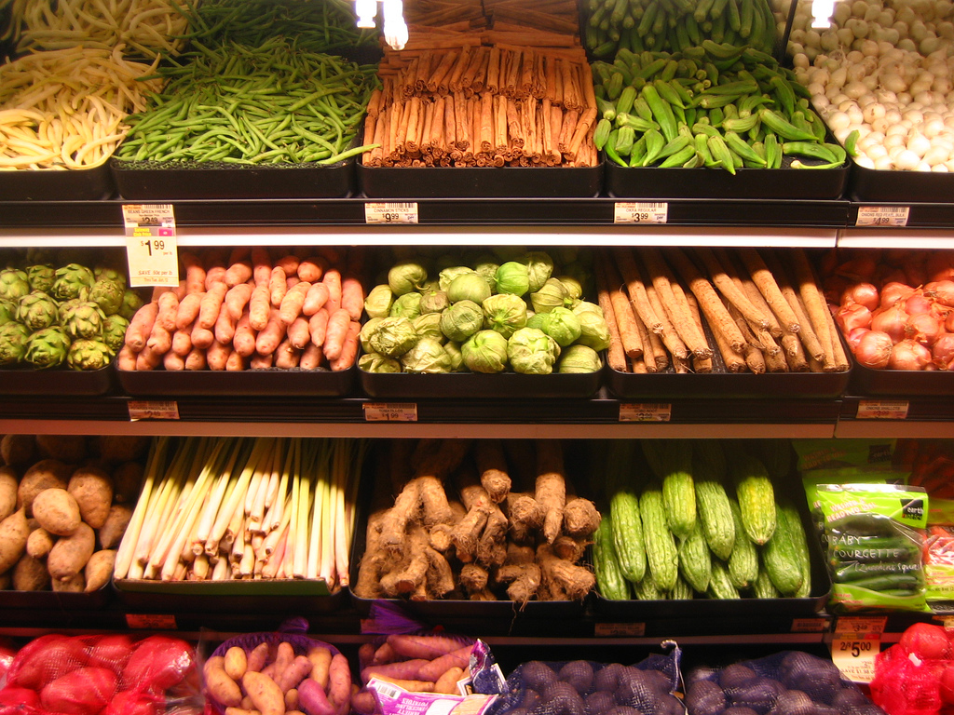
Our product is a “perishable”
(to borrow from the grocery store world)
Photo: rick

Slide 15

Client identifies
needed processes and reports
so the largest possible percent of the budget goes toward program execution.

Slide 16

which prevents paperwork
from impeding results

Slide 17
Client Buys into this Premise
What Elements Impact the HA Experience?

Slide 18
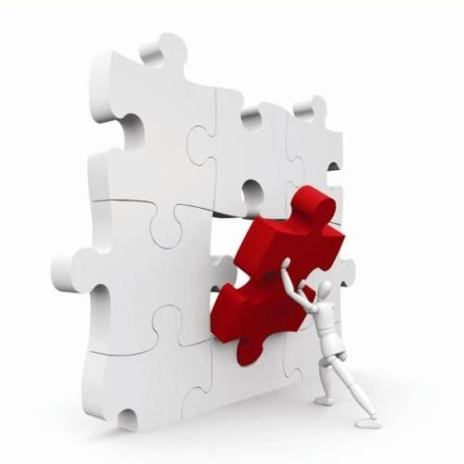
Our respective cultures play a role in the
simpatico factor.

Slide 19

*** open to a different visual***
Here’s what we value
Smarts
Egalitarian
Mentoring
Trust
Listening
Accountability
Can-do attitude
Curiosity
Contributions to the
success of others
Cross-cultural
Results-driven

Slide 20
There is a family-like quality
to our culture.

Slide 21

We say “family-like” because
if your Aunt Harriet isn’t the right fit, you don’t suggest she find another family.

Slide 22
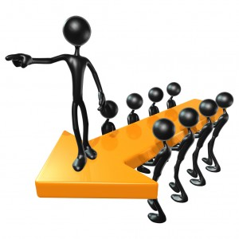
What motivates us?

Slide 23

Two-way Responsiveness

Slide 24


Slide 25

Flow of Information

Slide 26

Feedback
Image: tanakawho

Slide 27
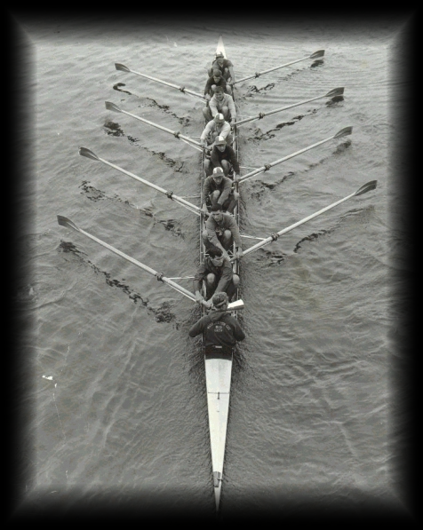
Feeling Part of the Team

Slide 28

Inventiveness
Image: JJay

Slide 29


Making a visible and meaningful difference

Slide 30
Did I mention
we can periodically
be temperamental?

Slide 31
It comes with
caring.

Slide 32
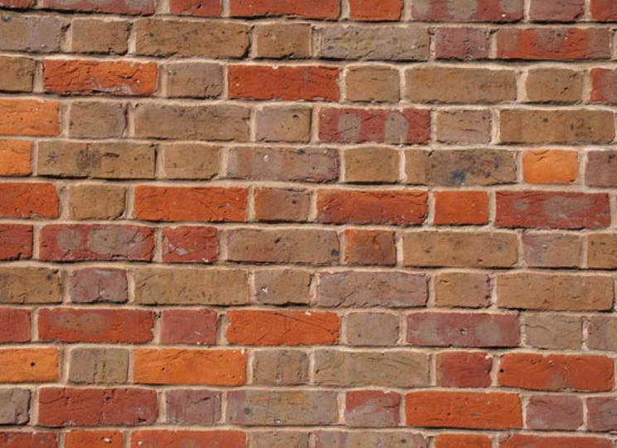
But we run through walls for our clients.

Slide 33
Let’s connect
The Hoffman Agency
Worldwide HQ
325 South 1st Street, 3rd Floor
San Jose, CA 95113
+1 (408) 286 2611
Let’s connect
©2022 The Hoffman Agency

