Slide 1


Slide 2
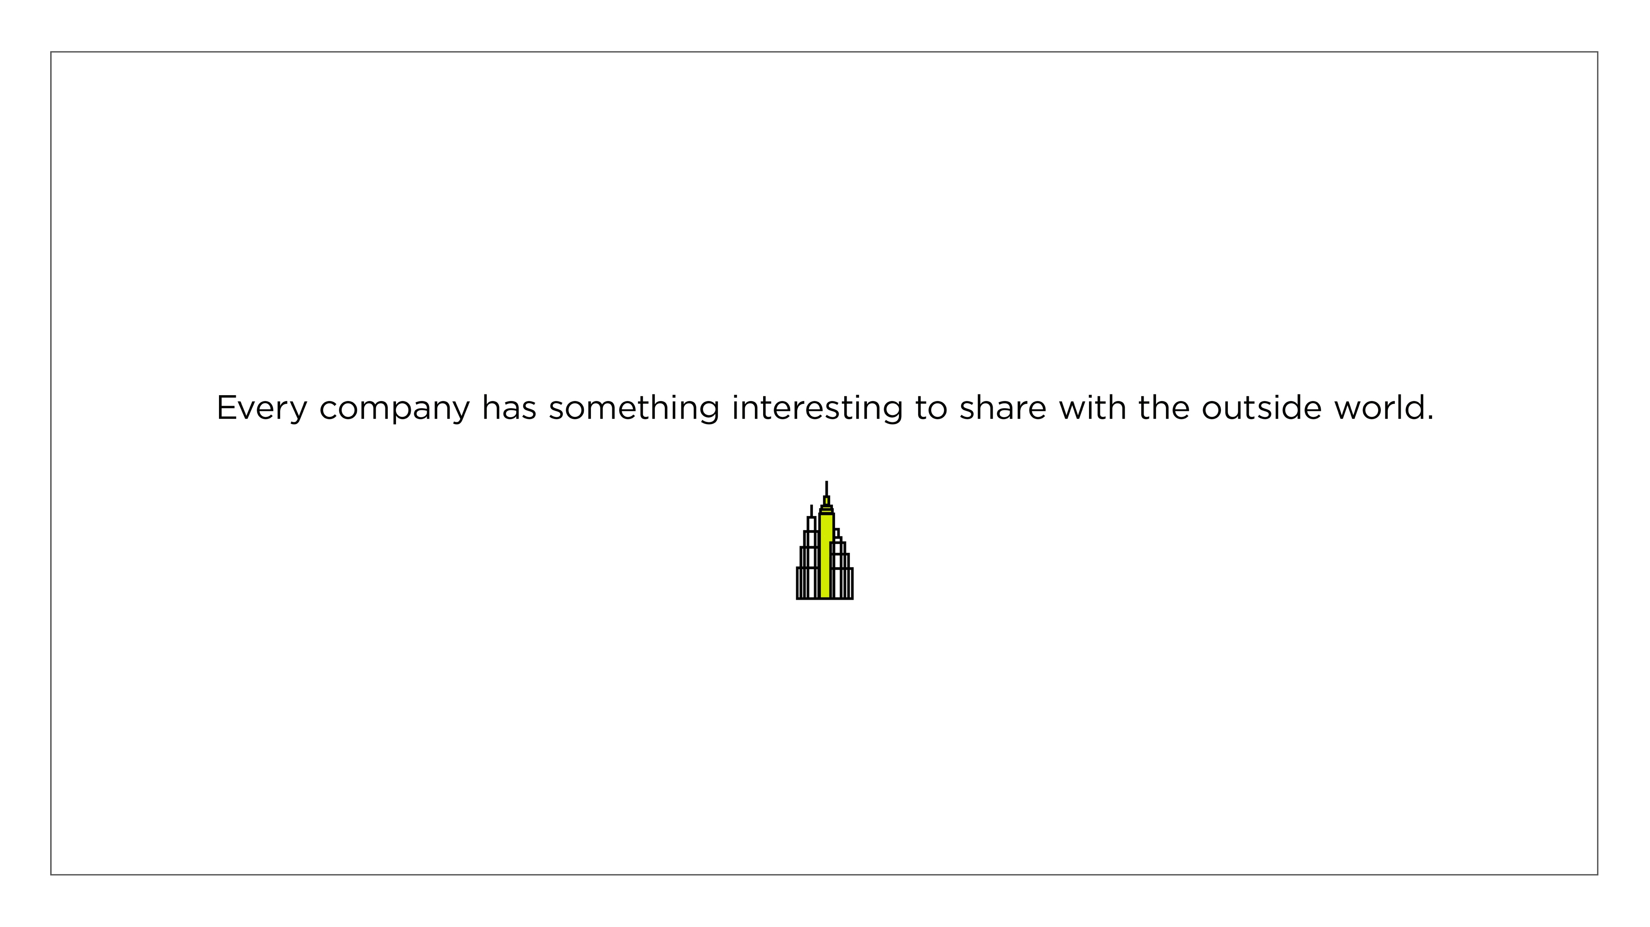

Slide 3


Slide 4

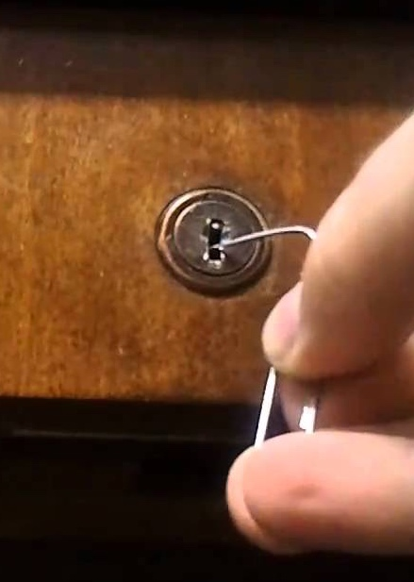

Slide 5


Slide 6


Slide 7


Slide 8
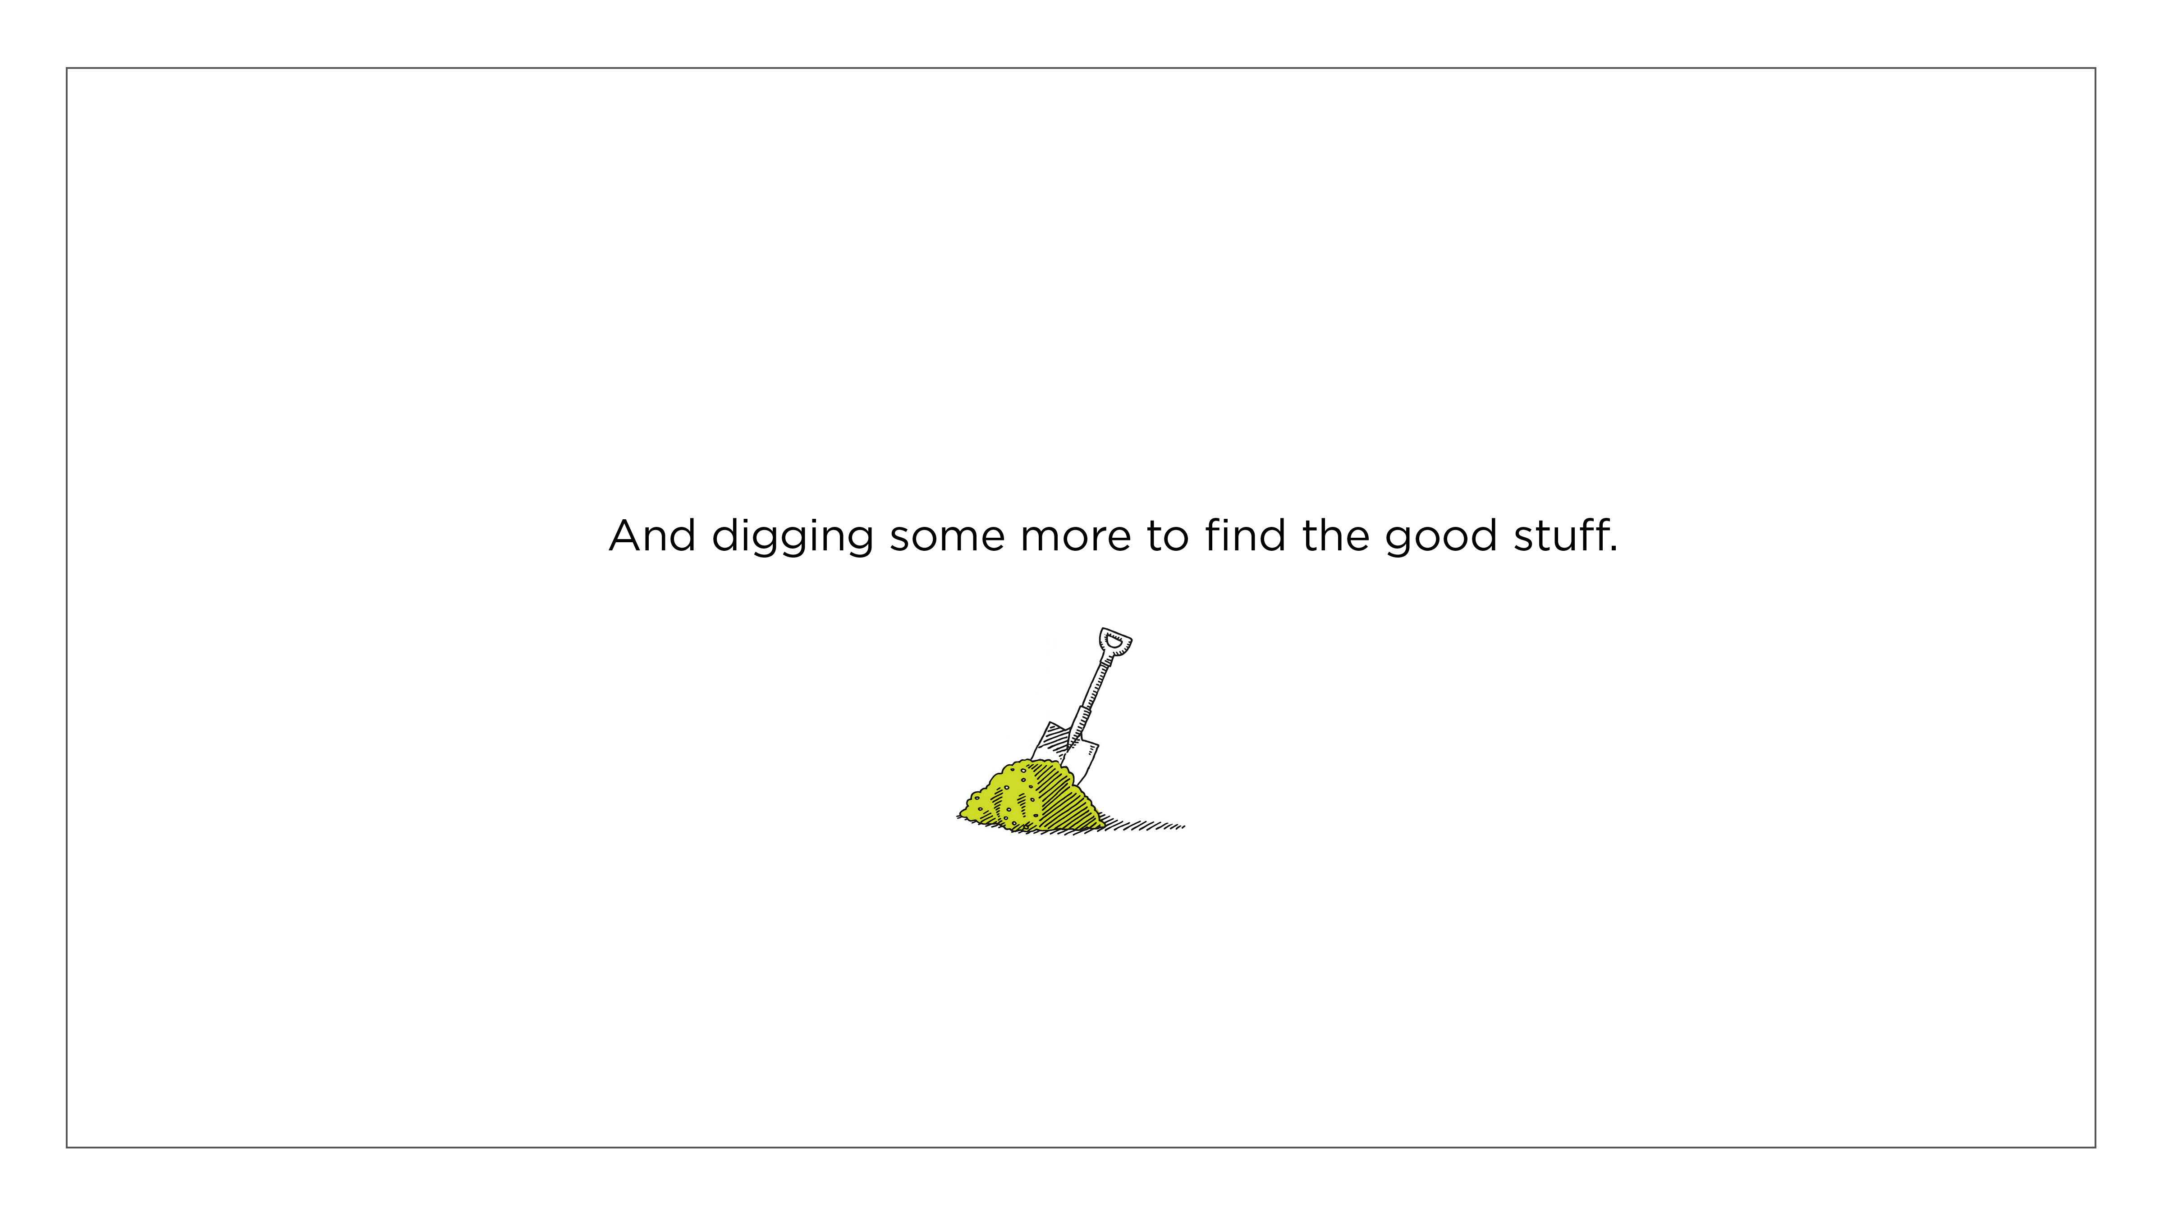

Slide 9


Several qualities come together
to discover this “good stuff.”
Research
Interviewing Techniques
Persistence
Dot-connecting Logic

Slide 10


And a leap of faith
(I just know you’re there)

Slide 11

Of course, when we say “the story is always
there,” we don’t
really mean story
by the conventional definition.

Slide 12
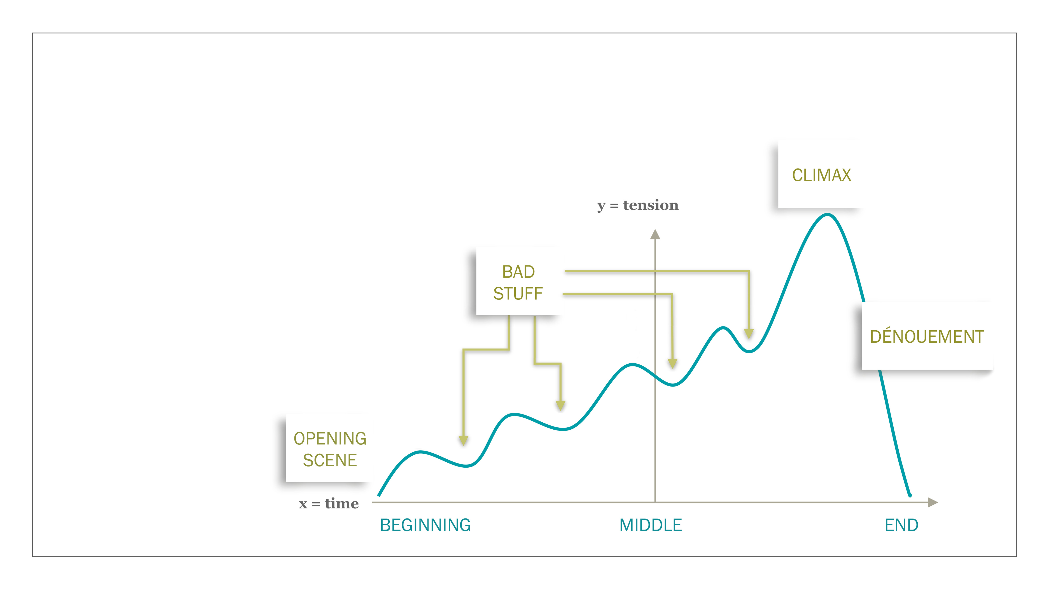
The conventional definition
of a story always includes
something going
horribly wrong

Slide 13

Virtually every movie, TV show
and book depends on “bad stuff”
to generate drama.

Slide 14

For example,
in the HBO show
“True Detective”
Mathew McConaughey goes from this

Slide 15
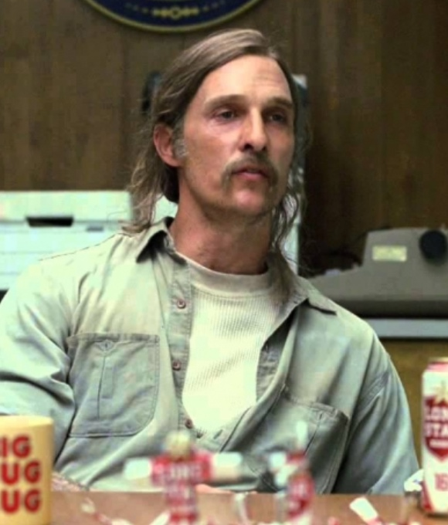
to this ...

Slide 16

But ends up
as this.

Slide 17
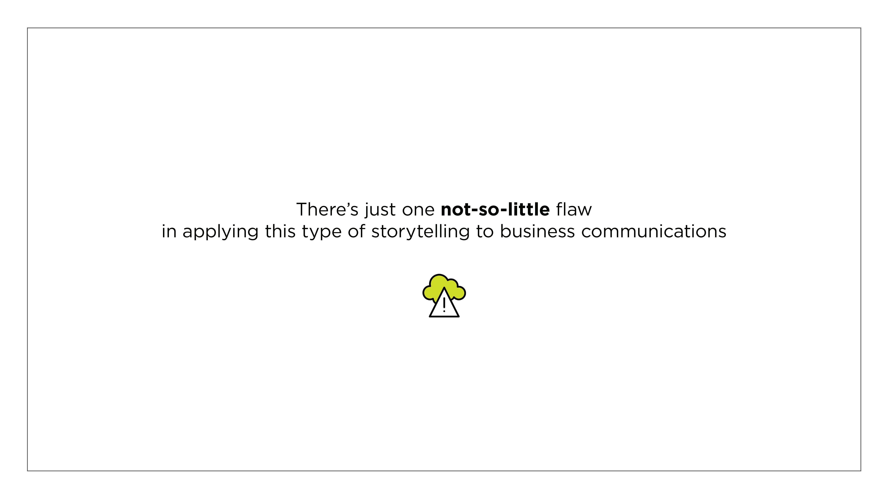

Slide 18
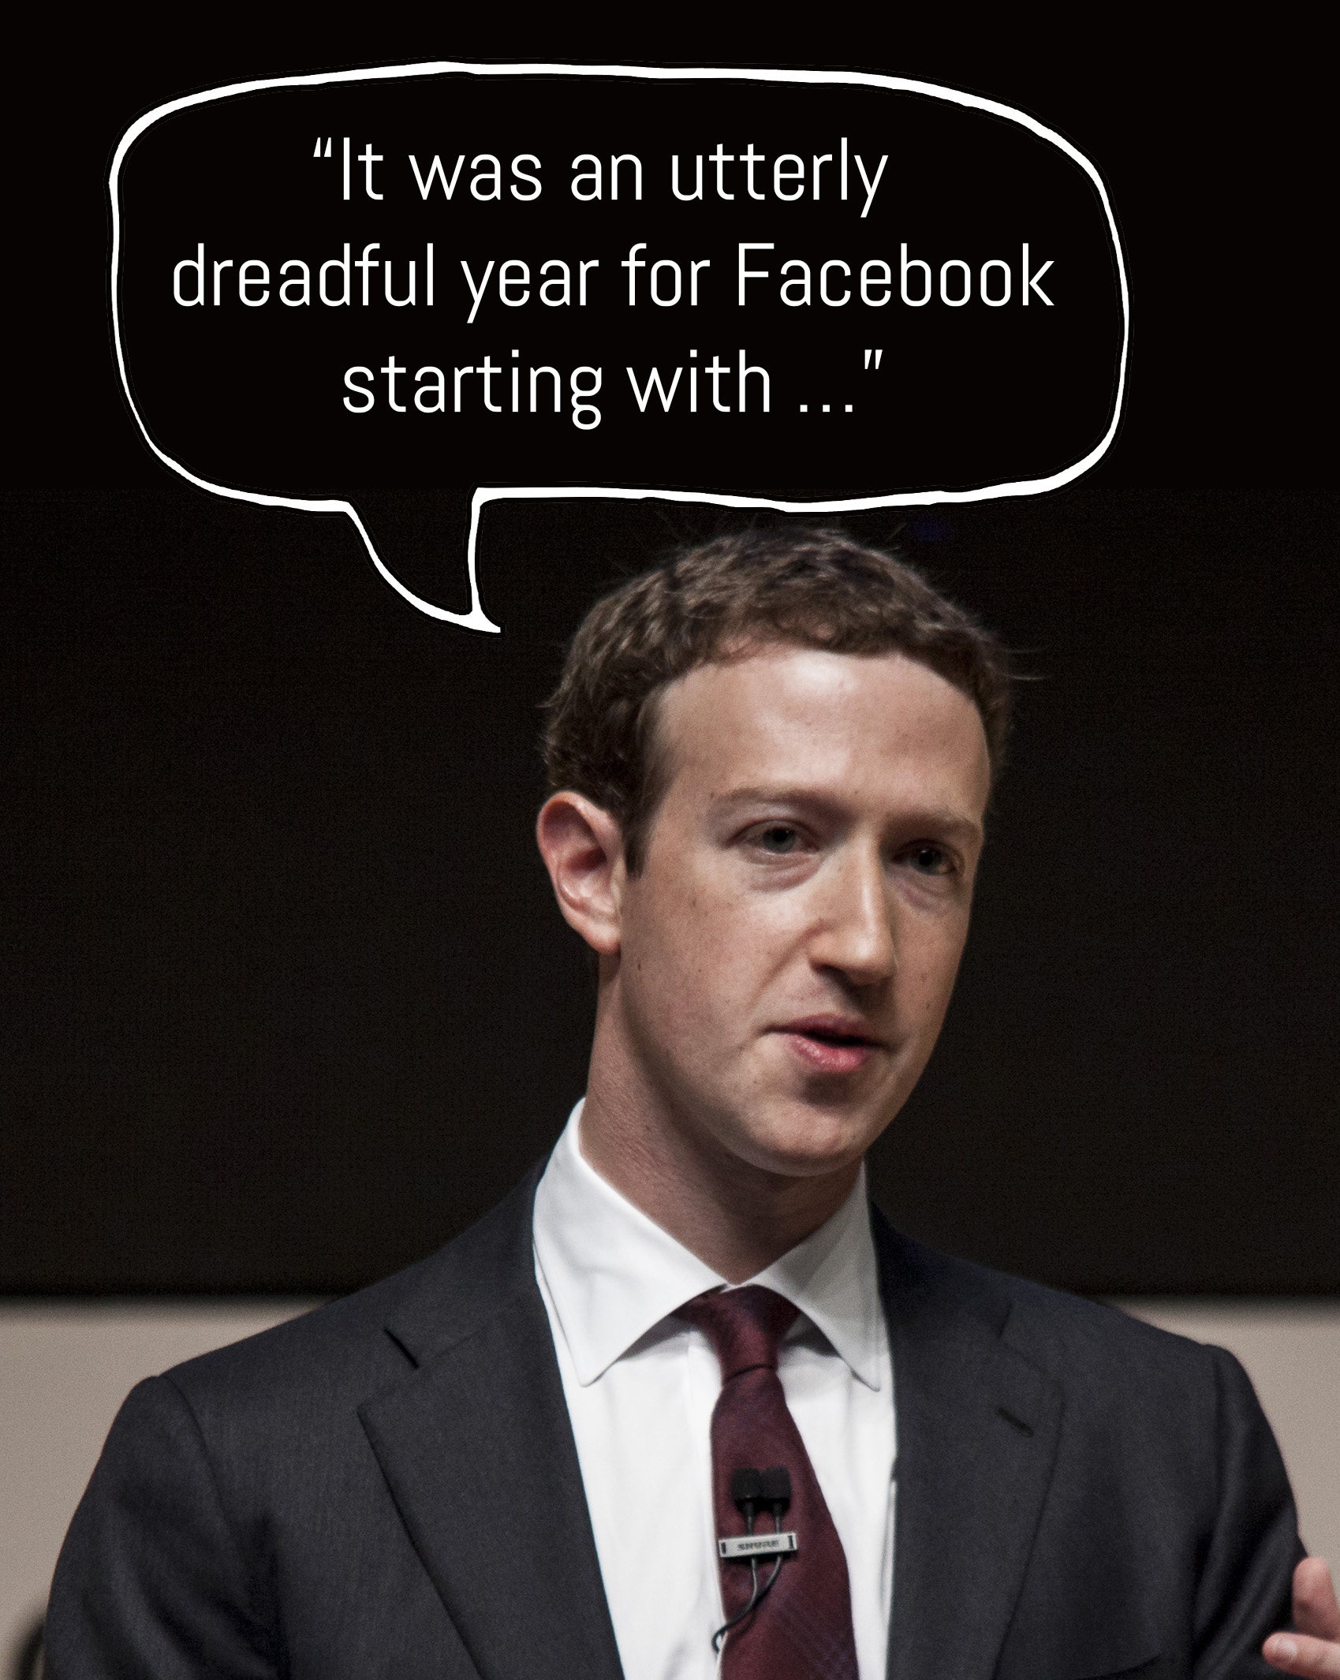
Companies
prefer to not share their mistakes
and problems
in public.

Slide 19
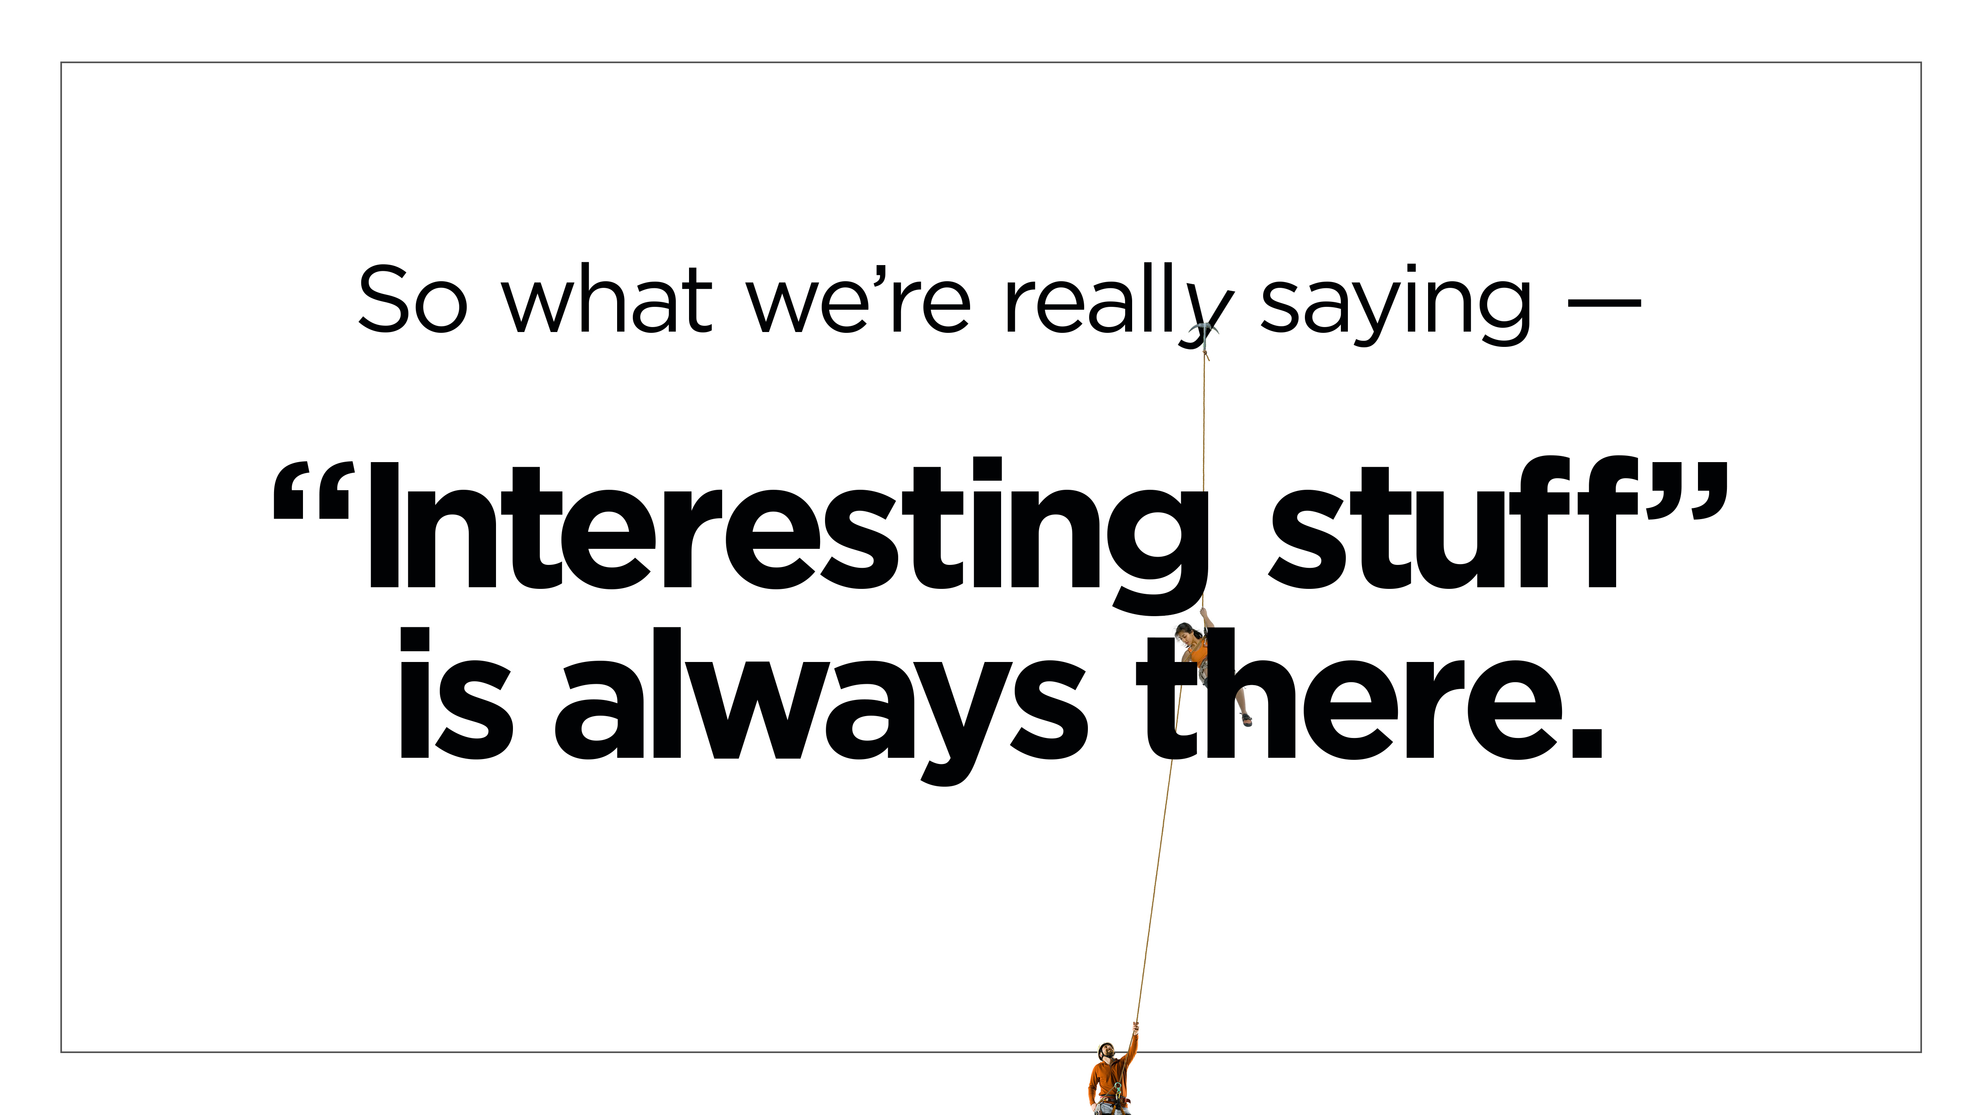

Slide 20
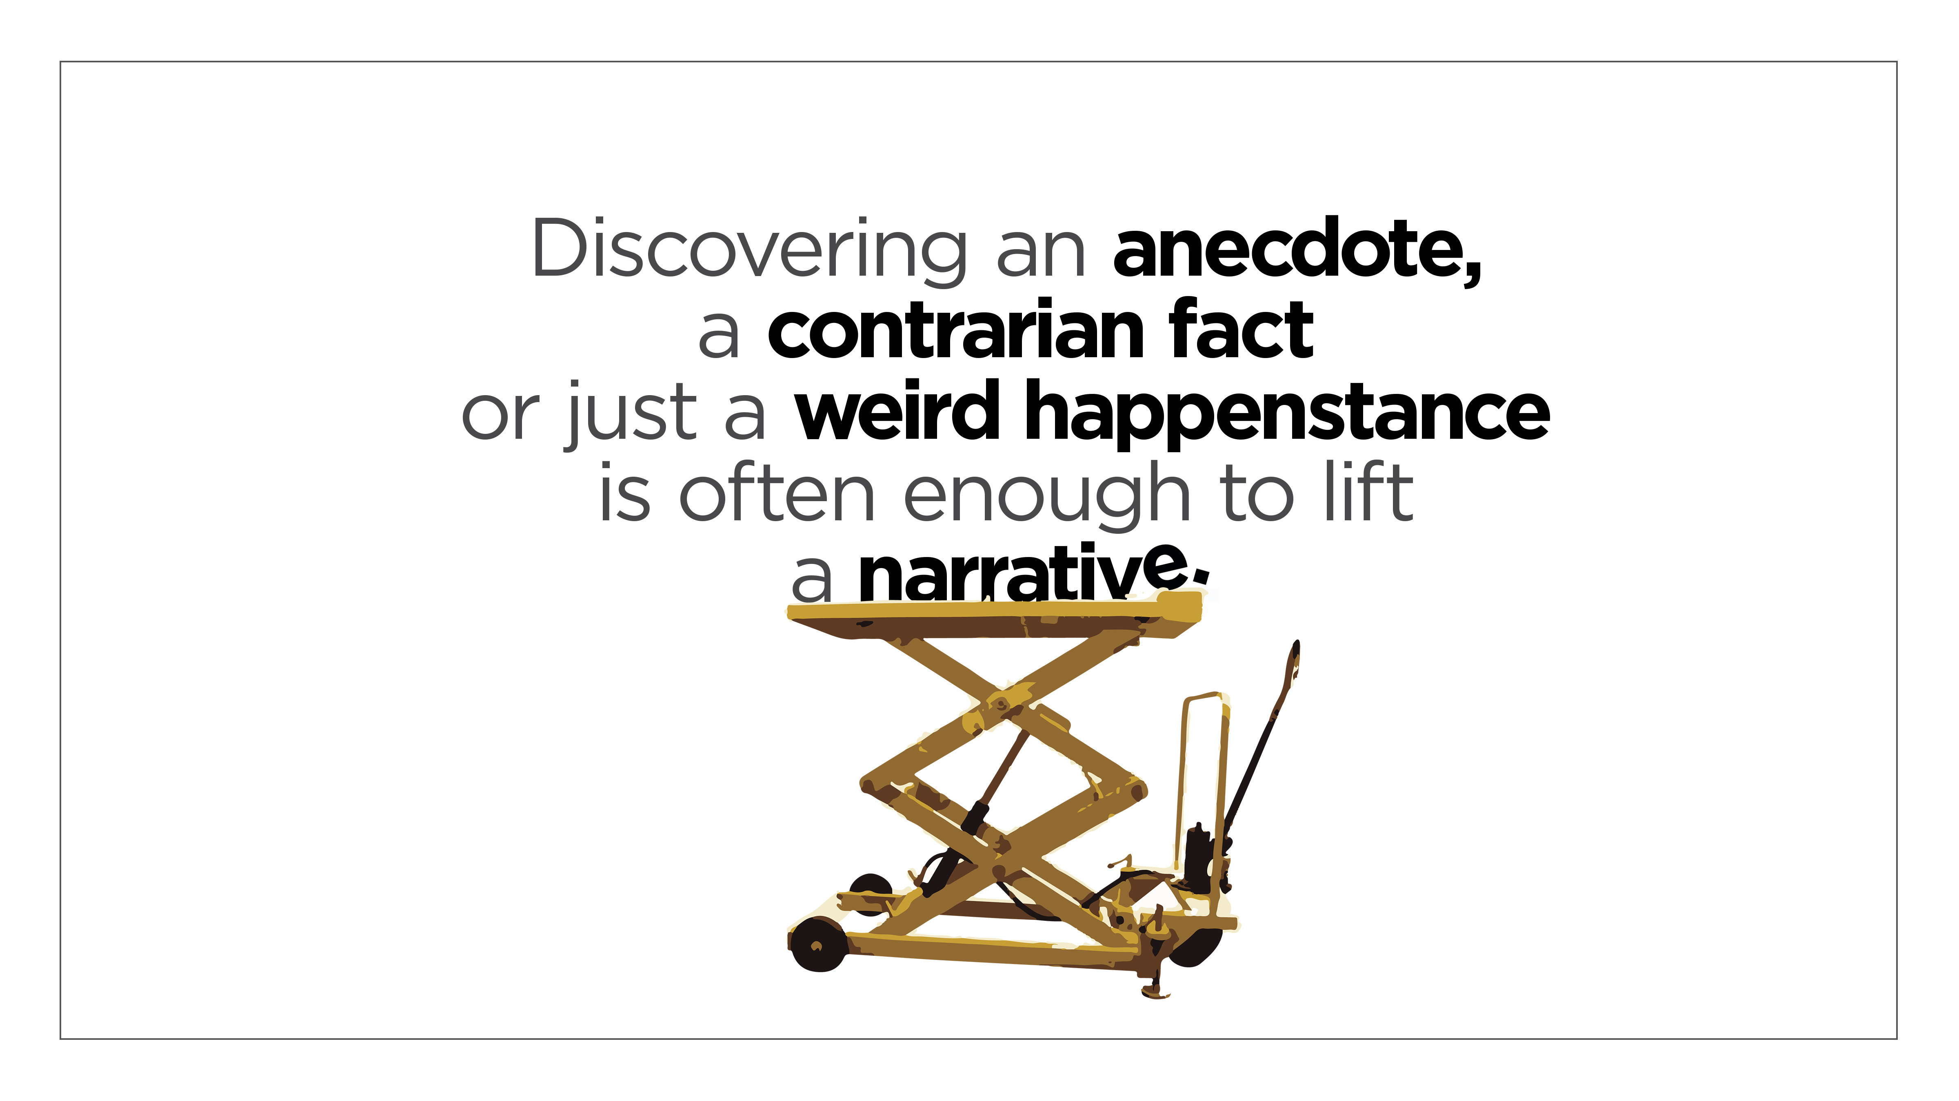

Slide 21


A photo ionization detector breaking down chemicals under an ultraviolet light doesn’t exactly get
the heart racing

Slide 22

But take that same monitor and catch paddle dopers,
table tennis players who add chemicals to their paddles
for greater spin …

Slide 23
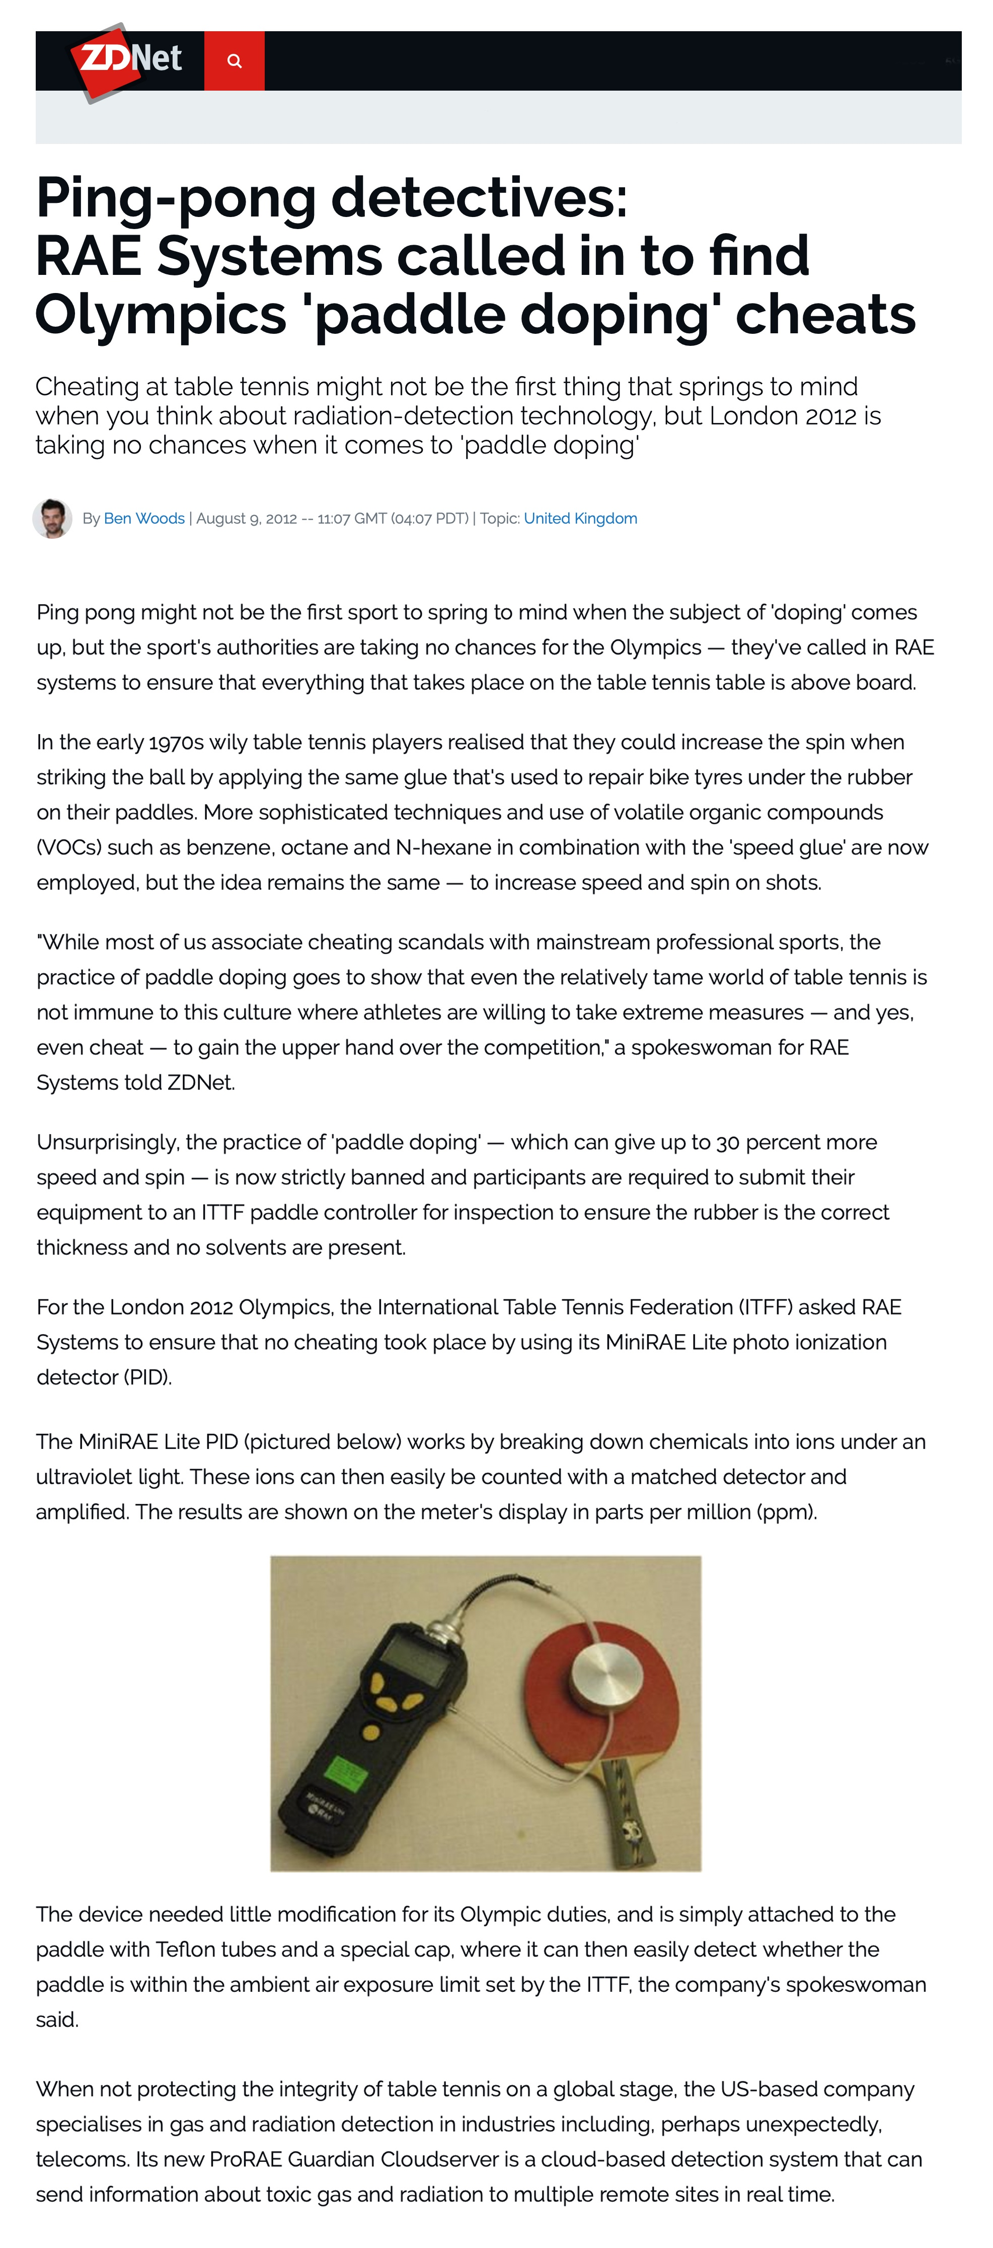
And now journalists
care about RAE Systems.

Slide 24
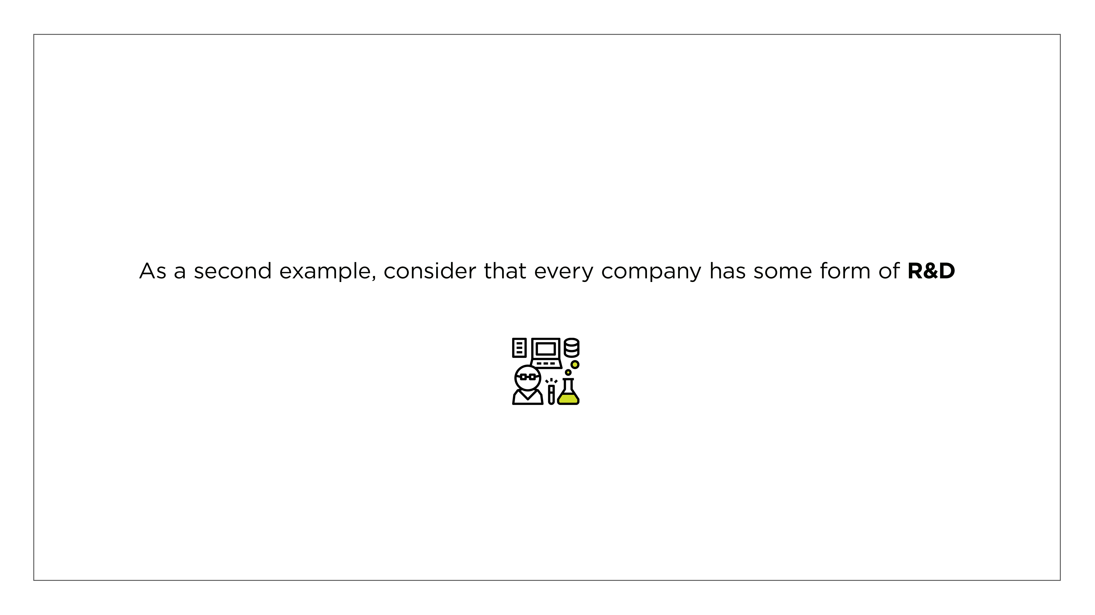

Slide 25

But when HP houses
an engineering team in an Airstream stocked with great snacks off campus, the plot thickens.

Slide 26
Journalists have always understood the power of back stories and what grabs people’s attention

Slide 27
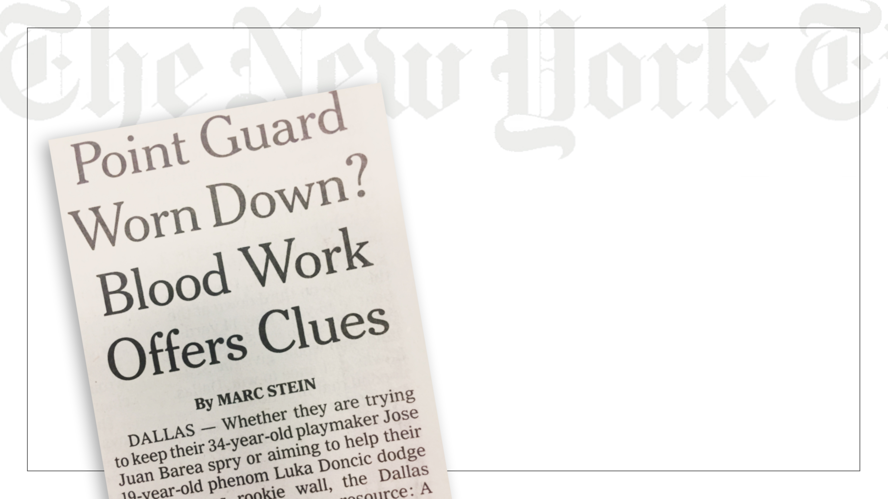
Especially sports journalists who otherwise would only write about game results.

Slide 28


Here’s the point.
The same storytelling techniques used
by journalists
can work for communicators
as well.
Click for Storytelling Microsite

Slide 29
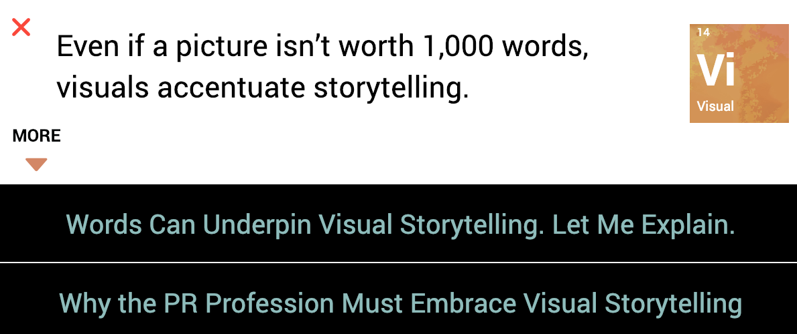
Think of it as
a guide for digging out the good stuff

Slide 30


Right,
the story
is always there.

Slide 31


Beyond applying storytelling techniques to our client campaigns,
we offer the following services:
STORYTELLING WORKSHOP
(3 VERSIONS)
  Executive Communications (emphasis on media)
  Internal PR Team
  Employees for General Communications
WEBSITE AUDIT AND RECOMMENDATIONS
  Analysis of Storytelling in Website Content
CORPORATE BLOG WORKSHOP
  Storytelling + Technical
BTW,
we walk the talk

Slide 32
We also blog on
storytelling through
a business prism at www.IshmaelsCorner.com

Slide 33


Slide 34
Our Contact Information
North America: Lou Hoffman 1 408 286-2611
Asia Pacific: Caroline Hsu + 852 2581-9380
Europe: Mark Pinsent + 44 (0)208 175 6791
Global: Lou Hoffman 1 408 286-2611

